Slide 1


The Case for Record Remediation at the Lesbian Herstory Archives
A presentation about my Fellowship at this community archive by Meg Carroll
Pratt Institute School of Information
In fulfilment of a Master’s in Library Science
INFOSHOW 2025

Slide 2

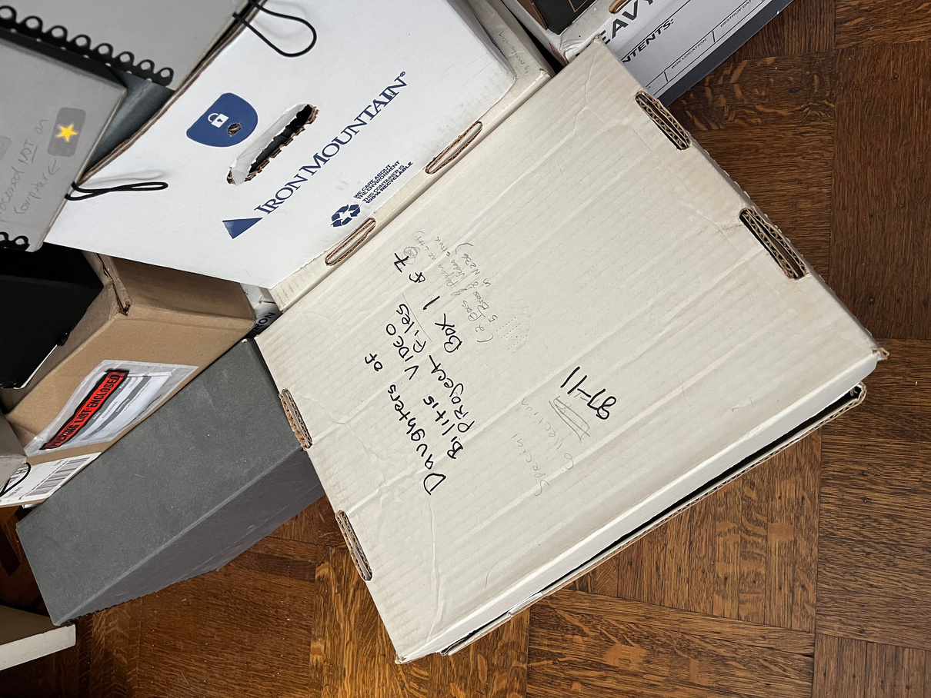

Borcelle
The day to day...
varied vastly! Some of my miscellaneous tasks included:
  Working with the Daughters of Bilitis files
  Improving connectivity in the Omeka site through checking for completeness and consistency in records
  Researching and modifying copyright information
  Editing the Omeka site to highlight that Pratt is making the main archival contributions
  Editing and making visible the LHA Cataloging Manual

Slide 3
Highlight: The LHA Cataloging Manual

Slide 4
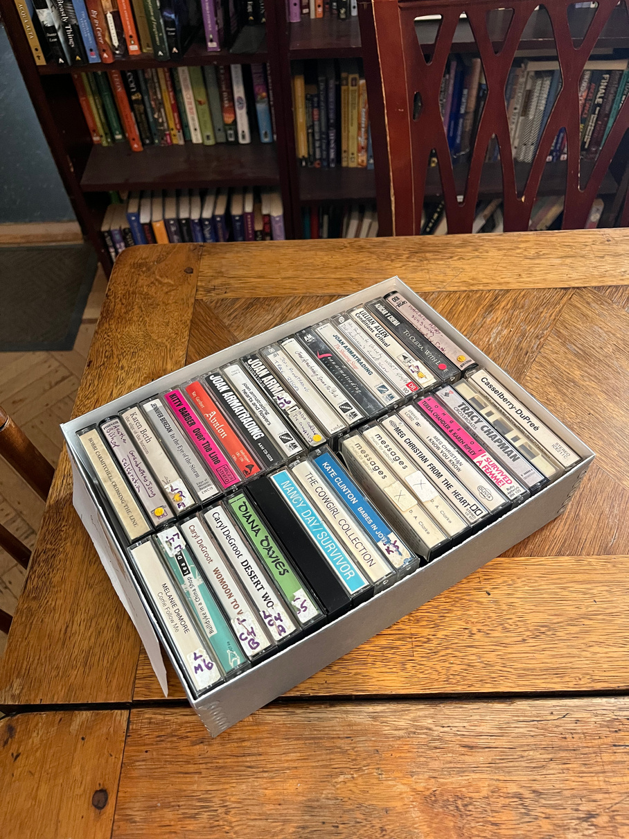
Borcelle
The start of my Fellowship at LHA and the Special Projects Class
While I was a Fellow, I was also taking Professor Anthony Cocciolo’s Special Projects in Digital Archives class, where we worked to digitize audiocassette tapes.
I was on the metadata team with Emilee Buytkinz and Emily Kokotajlo.

Slide 5

The problem we noticed...
was that there were many inconsistencies on the Omeka site. These included:
  Notating names differently
  Organizing items by physical carrier, resulting in an overly bloated collection tree
  Inconsistently notated tags
  Missing or incorrect copyright information

Slide 6
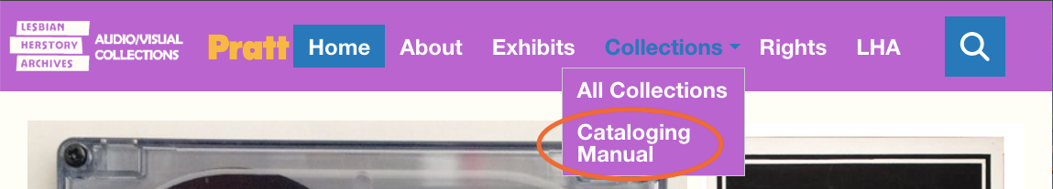
Borcelle
The solution...
was to create the LHA Cataloging Manual as a group.
I later uploaded this manual to the Omeka site during my time as a Fellow.

Slide 7
Uploading the document to the front end of the site
Archivists can practice transparency and attempt accountability by...
...explain[ing] in writing why choices were made as they were, using what criteria, based on what concepts of value or significance, employing what methodologies,
and reflecting what personal values of the archivist.
Joan M. Schwartz and Terry Cook, “Archives, records, and power: The making of modern memory”

Slide 8
Highlight: Copyright

Slide 9
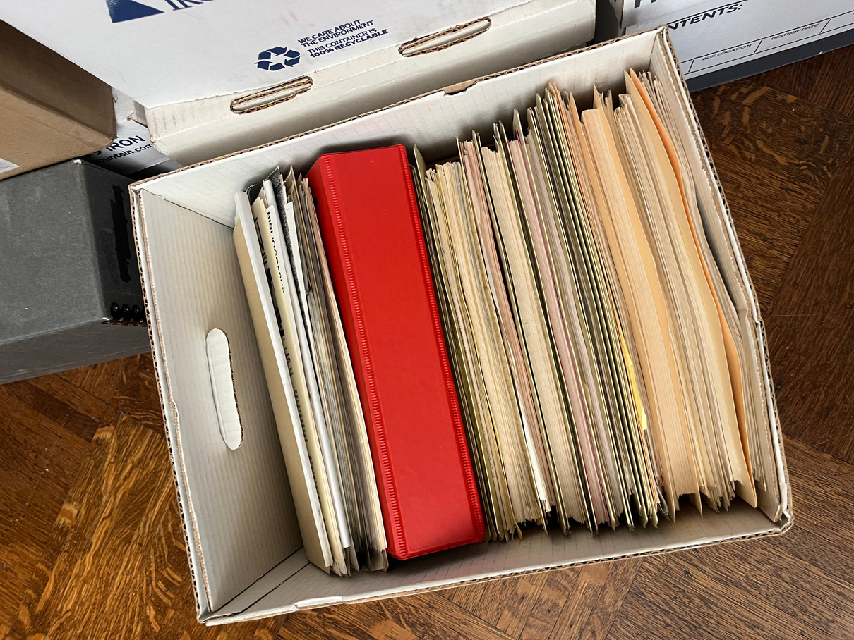
Borcelle
Another large problem we noticed...
was the inconsistency of the copyright information. So we
  Searched through LHA donor forms to find it or
  Put a notice on the materials to view the LHA Rights Page, followed by the CC BY-NC-ND notice

Slide 10
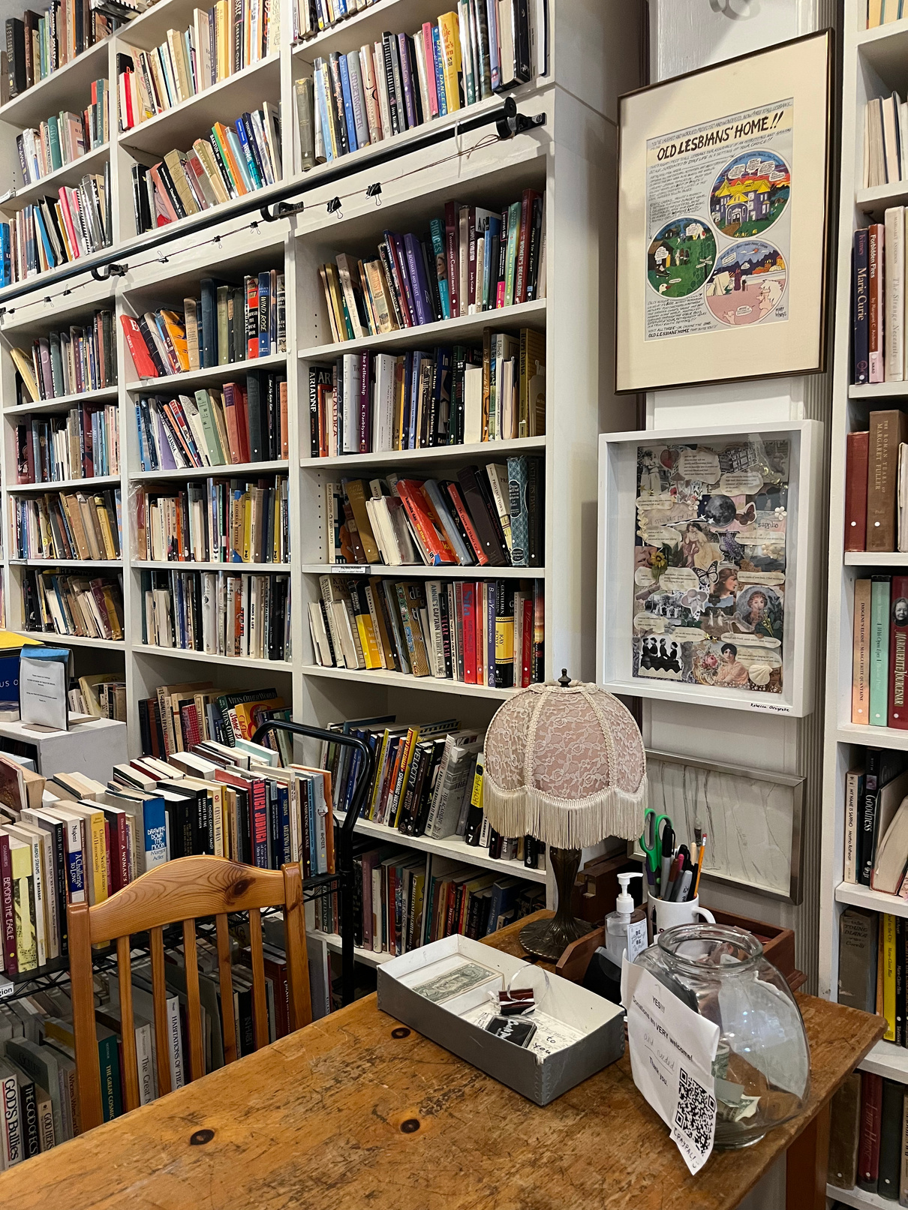
It was during this time...
that I was able to use recommendations made in the LHA Cataloging Manual to fix things such as
  misspelled or incorrectly formatted names
  scarce tags, namely adding people as tags, or creating new ones
  unclear or absent descriptions

Slide 11
Key Takeaways

Slide 12
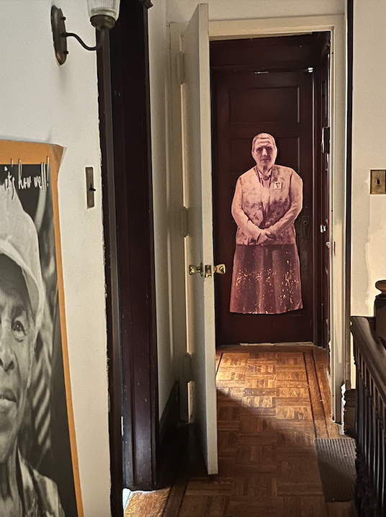
Remediation can happen case by case.
Metadata is not static. As records are revisited during routine archival work, they should be improved upon if inconsistencies are noticed.
If collections are exceptionally frequented, or information risks getting lost, targeted remediation may be necessary.

Slide 13
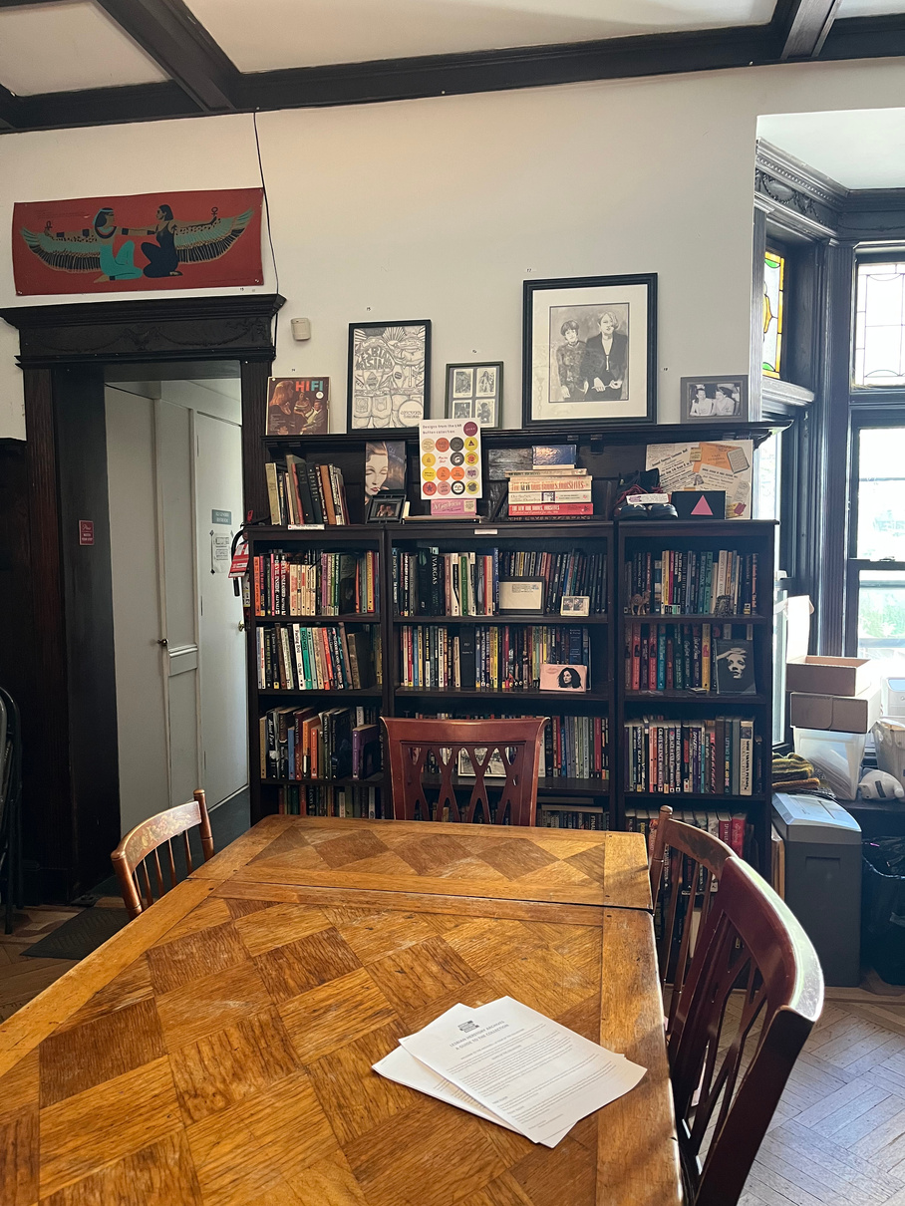
Borcelle
Communication across space and time is important!
In a community archive like LHA, people are often working at different rates, at different times, and with different levels of experience. Having a place like the Cataloging Manual to standardize some procedures and to build upon these procedures is vital to keeping everyone on the same page and standardizing the connectivity and presentation of information.

Slide 14
In Conclusion...

Slide 15
Borcelle
Record rehabilitation is about showing care.
Here, the archivist has an ethical obligation to empathize with all parties impacted by archival use – the communities for whom justice or impunity has lasting consequences,
the community of people for whom representation – or silencing – matters.
Michelle Caswell and Marika Cifor, “From Human Rights to Feminist Ethics: Radical Empathy In the Archives”
Notes:
From affective responsibility

Slide 16
Thank you for listening!
mcarr786@pratt.edu

