Slide 1
Mobile Museum App:
'DINOcent' Iteration
Ian Gregory Emotional Design 697-04

Slide 2
Project Summary
Roles:
Ian Gregory – Sole Researcher/Designer/Copywriter/Editor
Problem:
“How might we re-imagine a museum field trip for schoolchildren so that they receive a more personal and meaningful learning experience?”
Refined Problem Statement: “How might we gamify a museum field trip experience for schoolchildren so that they can create their own unique narrative as they explore a gallery?”
Goals:
Produce an engaging Learning Aid customized to specific Museums and Galleries which will inform school-age visitors of the material they are observing while they create their own unique narrative experience through a series of creative, text-based decisions

Slide 3
Process
Research:
Conducted Surveys, Interviews and Emotional Response activities to gain insight from the Primary & Secondary User groups, i.e., Grade School Students & Teachers
Design:
Originally conceived as a Digital Augmented Reality experience for smart devices with facial recognition capabilities and a customizable, interactive avatar, the current iteration is text-based with the addition of a semi-interactive "helper" called Rex
Aesthetics and narrative must be customized for each Museum and Exhibition
Evaluation:
Preliminary User testing of the current prototype iteration has been well received by both intended User Groups, but requires more depth of narrative and relevant information

Slide 4
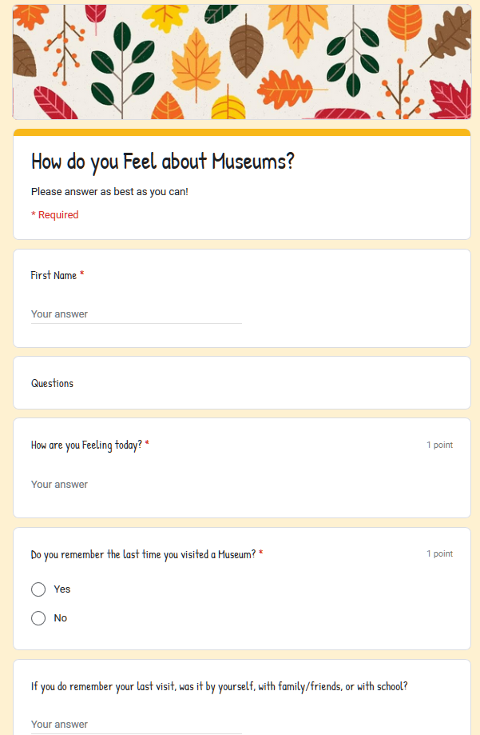
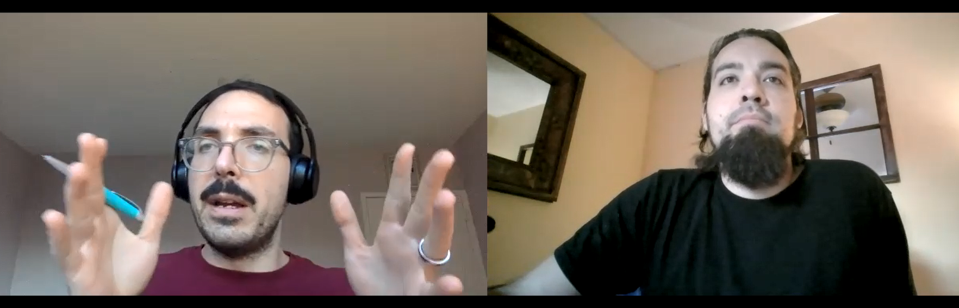
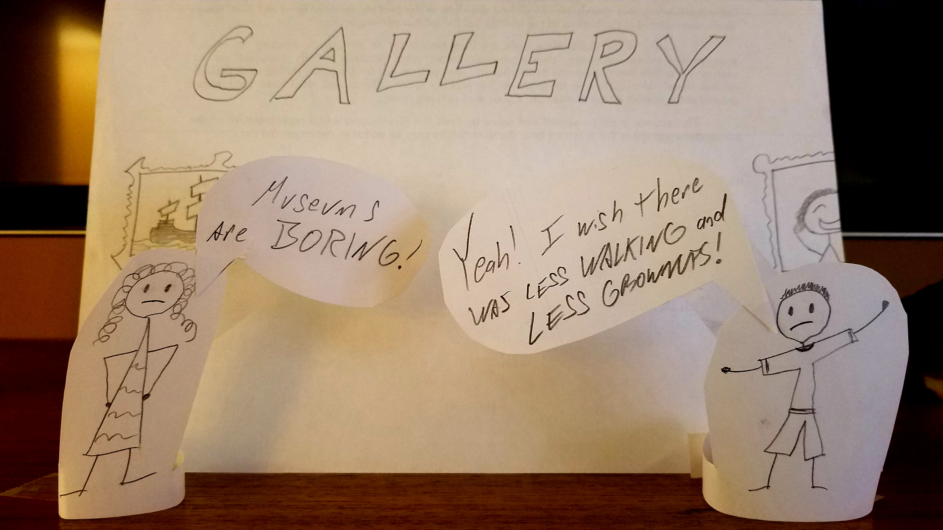
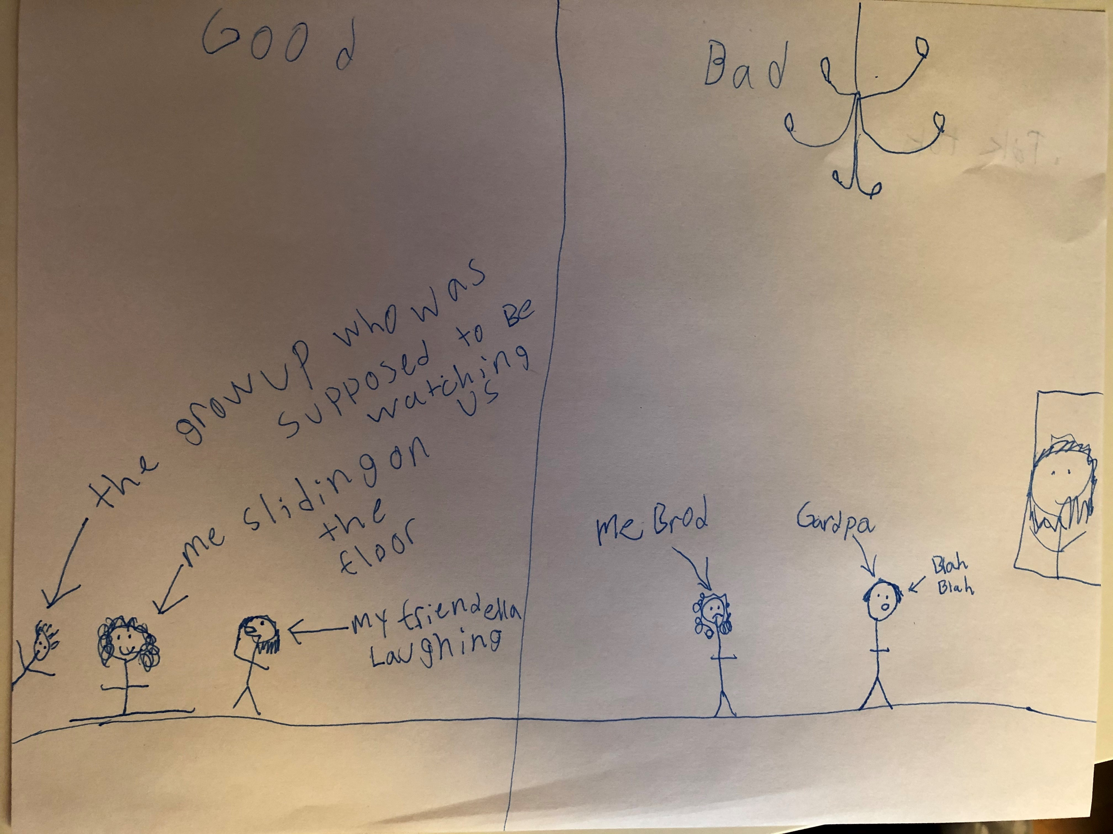
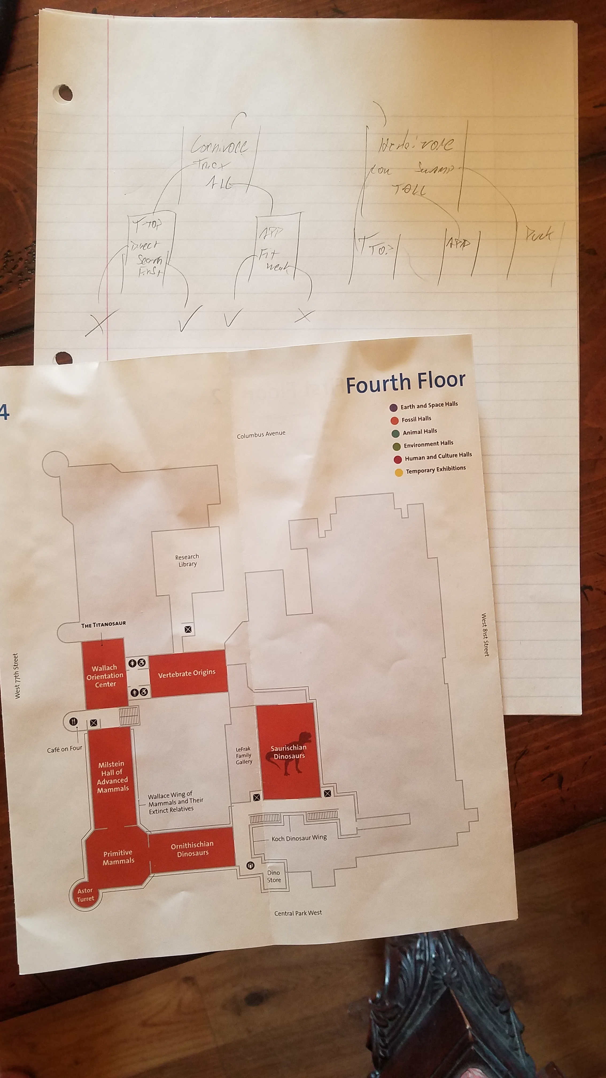
Documentation
Survey issued to school-aged Children
Screenshot of Teacher Interview
Physical Model of Student Persona & Early documents of 'DINOcent' iteration
One Example of Emotional Response Activity

Slide 5
Future Steps
Expansion of Format:
Narratives must be longer and more robust than current prototype, experience ends too quickly
'Age Group' or 'Grade' settings to adjust the content of the narrative to better suit broader demographics, including Teachers and possibly independent Adult patrons
Coordination with Museums:
Detailed knowledge of current Exhibitions and Collections is essential to success of the App, but deeper cooperation with Museums before an installation debuts could result in a more cohesive experience between the creative narrative and gallery navigation
Shareability:
Incorporate features to store completed "Adventures" on a User's device and allow it to be shared, posted, and re-experienced long after the Museum visit has concluded

