Slide 1
3D Scanning In Archives
Katie Wolf
651 – 02
November 27, 2017

Slide 2
How Does 3D Scanning Work?
A combination of laser beams and distance measurements
These lasers can be positioned in three dimensions
A camera measures how long it takes the laser to reach the object and then come back to the camera
Because we know how fast light moves, we can use the time to measure the distance!
d = (c * t)/2 (distance = speed multiplied by time, divided by 2, because it travels the distance twice
A second camera, in a different position from the laser, also helps triangulate the object, giving higher accuracy (but limiting the range)

Slide 3
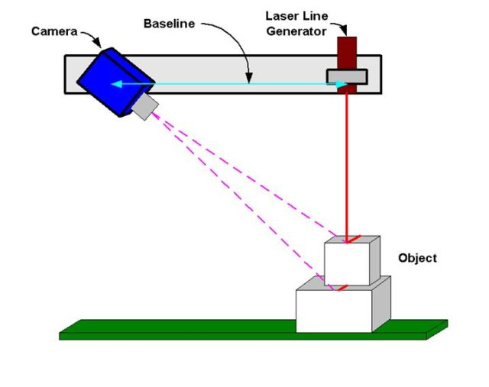
Diagram from Ian Wright, at https://www.engineering.com/AdvancedManufacturing/ArticleID/12390/Quality-Basics-How-Does-3D-Laser-Scanning-Work.aspx

Slide 4
Point Clouds
Once you’ve scanned the item, you’ve basically created a data set. This means that:
You’ve got data points that are set in a coordinate system (usually the familiar X, Y, Z Cartesian system). This is called a Point Cloud!
This data is then merged together and processed using software made specifically for 3D scanners
The data can be exported as an STL (Stereolithography or Standard Tessellation Language file) or changed to a NURBS (Non-Uniform Rational B-Spline) file, which is better for editing in a CAD program

Slide 5
This is what a point cloud looks like:
Diagram from Ian Wright, at https://www.engineering.com/AdvancedManufacturing/ArticleID/12390/Quality-Basics-How-Does-3D-Laser-Scanning-Work.aspx

Slide 6
This Process Can Either be Handheld…

Slide 7
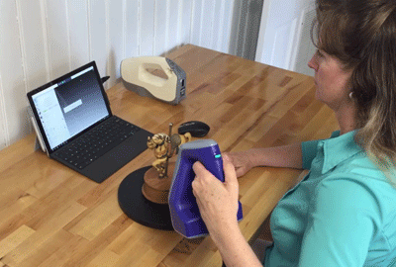
Image courtesy of Darryl Motley at https://gomeasure3d.com/blog/stationary-or-handheld-3d-scanner/

Slide 8
Or Stationary…

Slide 9
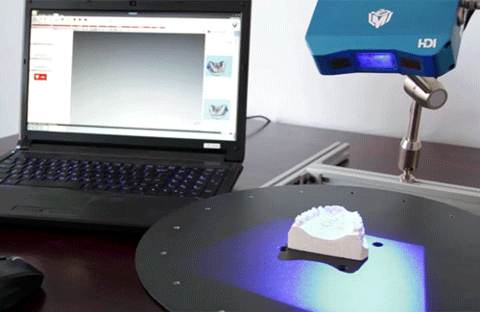
Image courtesy of Darryl Motley at https://gomeasure3d.com/blog/stationary-or-handheld-3d-scanner/

Slide 10
So Which is Better?
Handheld
Stationary
More portable
Don’t have to be continuously plugged in
Can scan hard to reach places and in confined spaces
Easier to use technology
Less processing power required
Better accuracy and resolution
Can quickly scan objects, especially if they are similar sizes
The process can be automated
Can handle a wide variety of sizes without sacrificing accuracy

Slide 11
How can this be used in archives or special collections?
There are a lot of benefits to this process.
It is non-contact, meaning there’s a low risk of damaging an object.
It creates a digital copy of an object.
This copy can be shared with other institutions easily.
This copy can also be printed using a 3D printer.
The digital copy exists in three dimensions, which is better than two-dimensional pictures
Replicas can be made easily and cheaply, which can then be shown to patrons, distributed, or used to aid in the restoration process.

Slide 12
Drawbacks of 3D Scanning
This method hasn’t been perfected yet, and there are a few issues that face archives looking to scan their collection.
Highly reflective surfaces don’t scan well. They interfere with how the laser is measured.
This can be accounted for using light-absorbing powder, but that isn’t ideal in an archival situation.
Objects that change shape when handled or need to be externally supported can be difficult to scan well.
Objects frequently need to be scanned from multiple angles in order to get a complete image, which requires a large time investment.
Digital objects frequently have “holes” in them, where the scans didn’t merge properly. This need to be fixed post-scan, which also takes a large amount of time.

Slide 13
3D Scanning at the UNT Libraries
The UNT Library system was able to experiment with 3D scanning in order to add to their digital collection.
They scanned miniature books (after trying a glass bottle collection and realizing it was too reflective to scan properly).
They were to upload multiple versions of their scans to their digital library.
They were also able to print out copies of the miniature books.

Slide 14
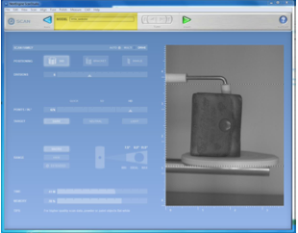
Scanning the object using at NextEngine 3D scanner. This is scanner uses 4 lasers and 2 cameras to achieve a very high level of accuracy. It comes with its own ScanStudio software to help process the scans.
Image courtesy of Marcia McIntosh, from https://digital.library.unt.edu/ark:/67531/metadc987458/

Slide 15
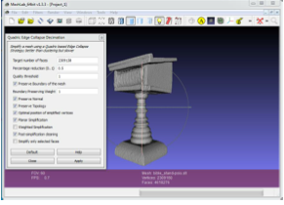
Processing the scan using MeshLab software. This allows the user to see any holes that the digital object has and patch them up. It also allows the user to smooth out any rough or inaccurate surfaces. The object can then be saved as an STL file, or even made into a gif!
Image courtesy of Marcia McIntosh, from https://digital.library.unt.edu/ark:/67531/metadc987458/

Slide 16
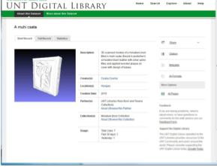
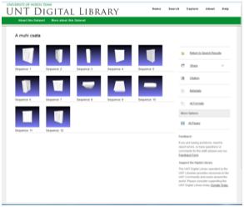
The digital objects were then uploaded to UNT’s digital library, where they can be browsed by the general public.
That can be done here: http://bit.ly/2gZuMuG
Image courtesy of Marcia McIntosh, from https://digital.library.unt.edu/ark:/67531/metadc987458/

Slide 17
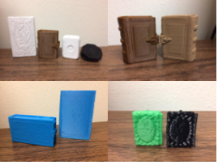
They were also able to print out copies of the books, using a 3D printer.
This is just one example of how this process can be and is used in a special collection.
Image courtesy of Marcia McIntosh, from https://digital.library.unt.edu/ark:/67531/metadc987458/

Slide 18
For the Public Good
This process is extremely helpful when it comes to digitizing 3D objects, especially very detailed and fragile ones. But it doesn’t have to be limited to helping out archivists. It can also be used to generate public interest.
3D scanning means 3D printing! Objects can be replicated, and these copies can be given out and shown to patrons without the fear of breaking them.
This means you can demonstrate how an object was used, without actually using the object. Great for old processes that are hard to explain with just words or pictures.
3D scans can also be used virtually. This means interacting with a digital object online or taking a tour of a 3D scanned space.
All of these options let the public interact with a collection in a new and immersive way, without worrying about damage.

Slide 19
3D Scanning at the Smithsonian Institute
The Smithsonian Institute also has a 3D scanning program. They are currently working on scanning the most high viewed or used items, and then making these scans public.
This is great because the Smithsonian can only display about 1% of their collection at a time.
It lets conservationists keep track of changes to an object over time.
They’ve created curated, digital “tours” of a few of their favorite objects. This is a great learning tool, especially for people who can’t actually visit the institute.
Explore more here!

Slide 20
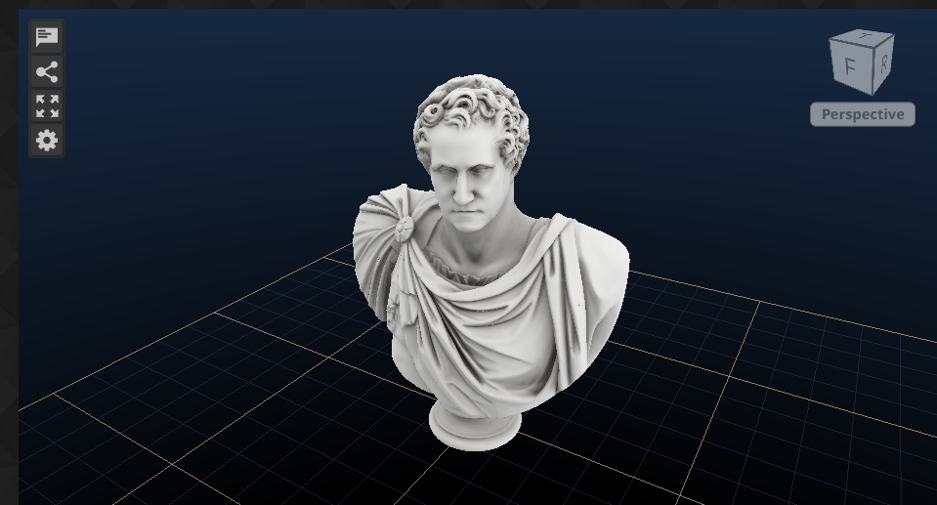
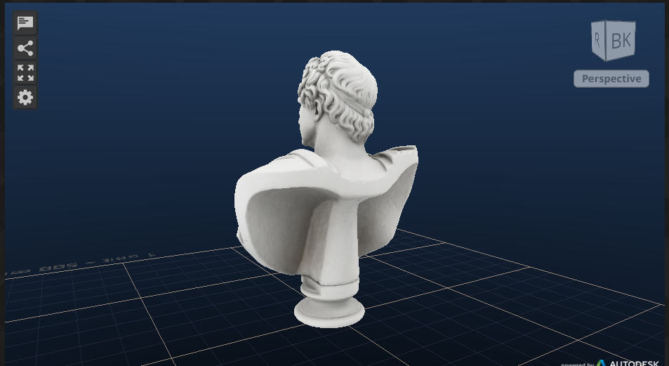
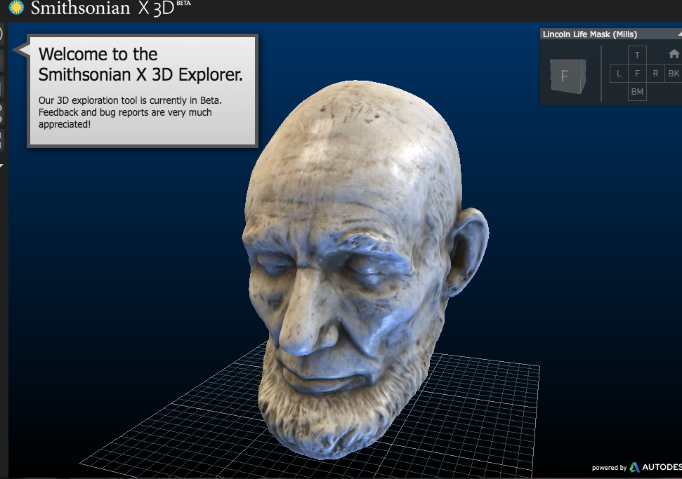
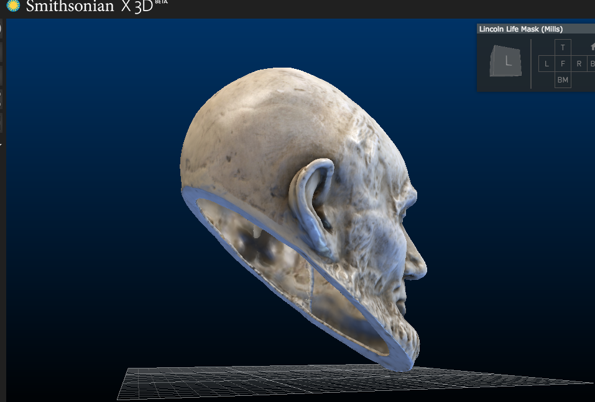
Images courtesy of the Smithsonian Institute, from https://3d.si.edu/

Slide 21
Why GLAM Institutions Should Pay Attention
This is a technology that has the potential to greatly benefit GLAM institutions, especially as the world moves further towards digital formats.
It allows for easier and more accurate digitization of 3D objects.
These digital objects can be shared and reproduced easily and cheaply.
It is a new tool for conservation and preservation that allows for more accurate repairs and replacements.
This technology will only get better and cheaper as more advancements are made.
It can generate public interest and participation, something that GLAMs can only benefit from.

Slide 22
Questions and comments?

Slide 23
References
Akca, Devrim; Grun, Armin; Breuckmann, Bernd; Lahanier, Christian. (2007). High definition 3D-scanning of arts objects and paintings. Optical 3-D measurement techniques conference, VIII, Zurich, Switzerland. Retrieved from https://www.research-collection.ethz.ch/bitstream/handle/20.500.11850/150930/eth-41336-01.pdf on November, 20, 2017. DOI https://dx.doi.org/10.3020/ethz-a-005748653
Alshawabkeh, Yahya; Haala, Norbert. (2004). Integration of Digital Photogrammetry and Laser Scanning for Heritage Documentation. Retrieved from http://www.isprs.org/proceedings/XXXV/congress/comm5/papers/590.pdf on November 20, 2017.
Boehler, W.; Marbs, A. (2002). 3D Scanning instruments. In Proceedings of the CIPA WG 6 International Workshop on Scanning for Cultural Hewritage Recording. Retrieved from https://i3mainz.hs-mainz.de/sites/default/files/public/data/p05_Boehler.pdf on November 20, 2017.
Boehler, W.; Marbs, A. (June, 2004). 3D Scanning and Photogrammetry for Heritage Recording: A Comparison. In Proceedings of 12th International Conf. on Geoinformatics. Retrieved from https://pdfs.semanticscholar.org/3316/69fffef6b2162fb4b1ca446bccefcc644f2b.pdf on November 20th, 2017.
Direct Dimensions. (2017). Almost Everything You Always Wanted to Know About 3D Scanning. Retrieved from http://www.dirdim.com/lm_everything.htm on November 20, 2017.
Evans, Kelsi. (November 1, 2017). Stories from the Makers Lab: A Proof of Concept. UCSF Library News. Retrieved from https://www.library.ucsf.edu/news/stories-from-the-makers-lab-a-proof-of-concept-2/ on November 20, 2017.
Means, Bernard K.; Bowles, Courtney; McCusition, Ashley; King, Clinto. (May, 2013). Virtual Artifact Curation: Three-Dimensional Digital Data Collection for Artifact Analysis and Interpretation. Department of Defense Legacy Resource Management Program. Retrieved from https://www.academia.edu/4168204/Final_Report_Virtual_Artifact_Curation_Three-Dimensional_Digital_Data_Collection_for_Artifact_Analysis_and_Interpretation on November 20, 2017.
McIntosh, Marcia. (July 31, 2017). Investigations into the Third Dimension: 3D Scanning in UNT Libraries' Digital Collections. Retrieved from https://digital.library.unt.edu/ark:/67531/metadc987458/ on November 20, 2017.
Motley, Darryl. (February 28, 2017). Choosing Between a Stationary or Handheld 3D Scanner. GoMeasure3D. Retrieved from https://gomeasure3d.com/blog/stationary-or-handheld-3d-scanner/ on November 25, 2017.
NextEngine Gallery. (2017). NextEngine, Inc. Website. http://www.nextengine.com/faq accessed November 20, 2017.

Slide 24
References
Reuscher, Jason A. (Spring, 2014). Three-Dimensional (3-D) Scanning Within Academic Libraries: Exploring and Considering a New Public Service. PaLA College & Research Division: Vo. 2, No. 1. Retrieved from http://citeseerx.ist.psu.edu/viewdoc/download?doi=10.1.1.830.7607&rep=rep1&type=pdf November 20, 2017. DOI http://dx.doi.org/10.5195/palrap.2014.56
Smith, Briallyn. (October 14, 2015). "How Do 3D Scanners Work and Should You Buy One?" Technology Explained: Makeuseof.com. Retrieved from http://www.makeuseof.com/tag/3d-scanners-work-buy-one/ on November 20, 2017.
Smithsonian X 3D. (2016) Smithsonian Institution. Digitization Program Office. Office of the Chief Information Officer. http://3d.si.edu/
Wachowiak, Melvin J.; Karas, Basiliki Vicky. (July 18, 2013). 3D Scanning and Replication for Museum and Cultural Heritage Applications. Retrieved from https://www.si.edu/content/MCIImagingStudio/papers/scanning_paper.pdf on November 20, 2017. DOI: http://dx.doi.org/10.1179/019713609804516992
Wright, Ian. (June 14, 2016). Quality Basics: How Does 3D Laser Scanning Work?. Retrieved from https://www.engineering.com/AdvancedManufacturing/ArticleID/12390/Quality-Basics-How-Does-3D-Laser-Scanning-Work.aspx on November 25, 2017

