Slide 1
Building a
21st Century
Public Library
Lauren Baker
May 17, 2017
LIS 651-01
Information Professions
Notes:
Today, I’d like to talk about Building a 21st Century Public Library. I will focus on examples of libraries in the US built since 2004 and how the design of space meets people’s needs. With that in mind…

Slide 2
Library as “third place”
Neither home nor work, these are features of “third places”:
Neutral
Inclusive
Encourage conversation
Accessible and accommodating
Have ”regulars”
Home away from home
Playful, fun
Physically plain
(Oldenburg, 1989)
Notes:
I’d like to begin by introducing the concept of the ”third place,” which is driving current discussions about public library design. This idea comes from Richard Oldenburg. He explains that 1st place is home. 2nd place is work, and 3rd place is anywhere people gather casually for conversation – these are coffee shops, bars, barbershops. Oldenburg didn’t mention libraries in his original work, but libraries fit many aspects of third places (Molz & Dain, 1999). The only one of these criteria that doesn’t really fit the examples I’m going to show today is “physically plain.” Oldenburg was thinking about your neighborhood bar or bowling alley, and all of the library designs I’m going to present except for one, are really striving to be aesthetically beautiful as well as community-oriented.
[But all of his other points apply, and as books become less of the central focus of the library and new forms of media are coming in, there is a trend in the library world of creating the library as a center for the community for social interaction and civic engagement (Feinberg & Keller, 2010). ]

Slide 3
How do people feel about public libraries?
How do people use public libraries?
What do people want from their public libraries?
What role can architecture play?
Notes:
When thinking about the physical design of public library buildings, it’s really a discussion about values, needs, and goals.
The questions I’d like to address today are:
How do people feel about their public libraries?
How do they use them?
What do they want from them?
And what’s architecture’s role in all this?

Slide 4
1 How do people feel about public libraries?
Notes:
So let’s start with how people feel about their public libraries.

Slide 5
/
2
of people report “that closing their local public library would have a major impact on their community”
3
/
1
of people report “that closing their local public library would have a major impact on
them and their family”
3
(Horrigan, 2015)
Notes:
The Pew Research Center conducted a nationally representative survey of Americans 16 and older and found that 2/3 of people said that closing their local public library would have a major impact on their community and 1/3 said that closing their library would have a direct impact on them and their family
Women, Latinos, older adults (those 50 and up), and parents with young children are even more likely to say that closing their local public library would have a major impact on their community.

Slide 6
2 How do people use public libraries?
Notes:
How do people actually use public libraries? Because this will help dictate the design.

Slide 7
In the past year, how have people used public libraries?
Visited in-person
Of those who visited:
Borrowed print books
Place to read/study
Asked a librarian for help
Used computer/internet/WiFi
2015
46%
66%
53%
42%
27%
(Horrigan, 2015)
Notes:
These results, also from the Pew Study, show that a little less than half of Americans have visited the public library in-person in 2015.
Of those who visited, borrowing books was still the most important activity.
A little more than half used the library as a place to sit and read.
Fewer engaged with a librarian.
And a little more than a quarter used a computer or accessed the Internet.

Slide 8
3 What do people want from their public libraries?

Slide 9
Public libraries should provide
Education
Reading Spaces
New Technologies
Services for Special Constituencies
Job Training & Business Development
(Horrigan, 2015)
Notes:
Again this is from the Pew study, but it is echoed by reports from the American Librarian Association and the Public Library Association.
Americans want five things from their public libraries.
Education: Offer early literacy programs, work with local schools to provide resources to children, teach all ages about technology
Reading Spaces: Have comfortable seating to read, work, and relax at the library, suggesting the importance of the library as a physical place to go.
New Technologies: Provide access to 3D printers and digital tools to enable making things
Services for Special Constituencies: like veterans, active-duty military personnel and immigrants
Finally, Job Training & Business Development: Help local businesses and entrepreneurs

Slide 10
4 What role can architecture play?
Notes:
Can buildings create new spaces more conducive to how libraries are actually being used now and what people say they want from their libraries? Let’s look at some examples.

Slide 11
Seattle Central Library
Location: Seattle, WA
Architect: OMA + LMN
Year: 2004
Notes:
The Seattle Central Library was built in 2004.

Slide 12
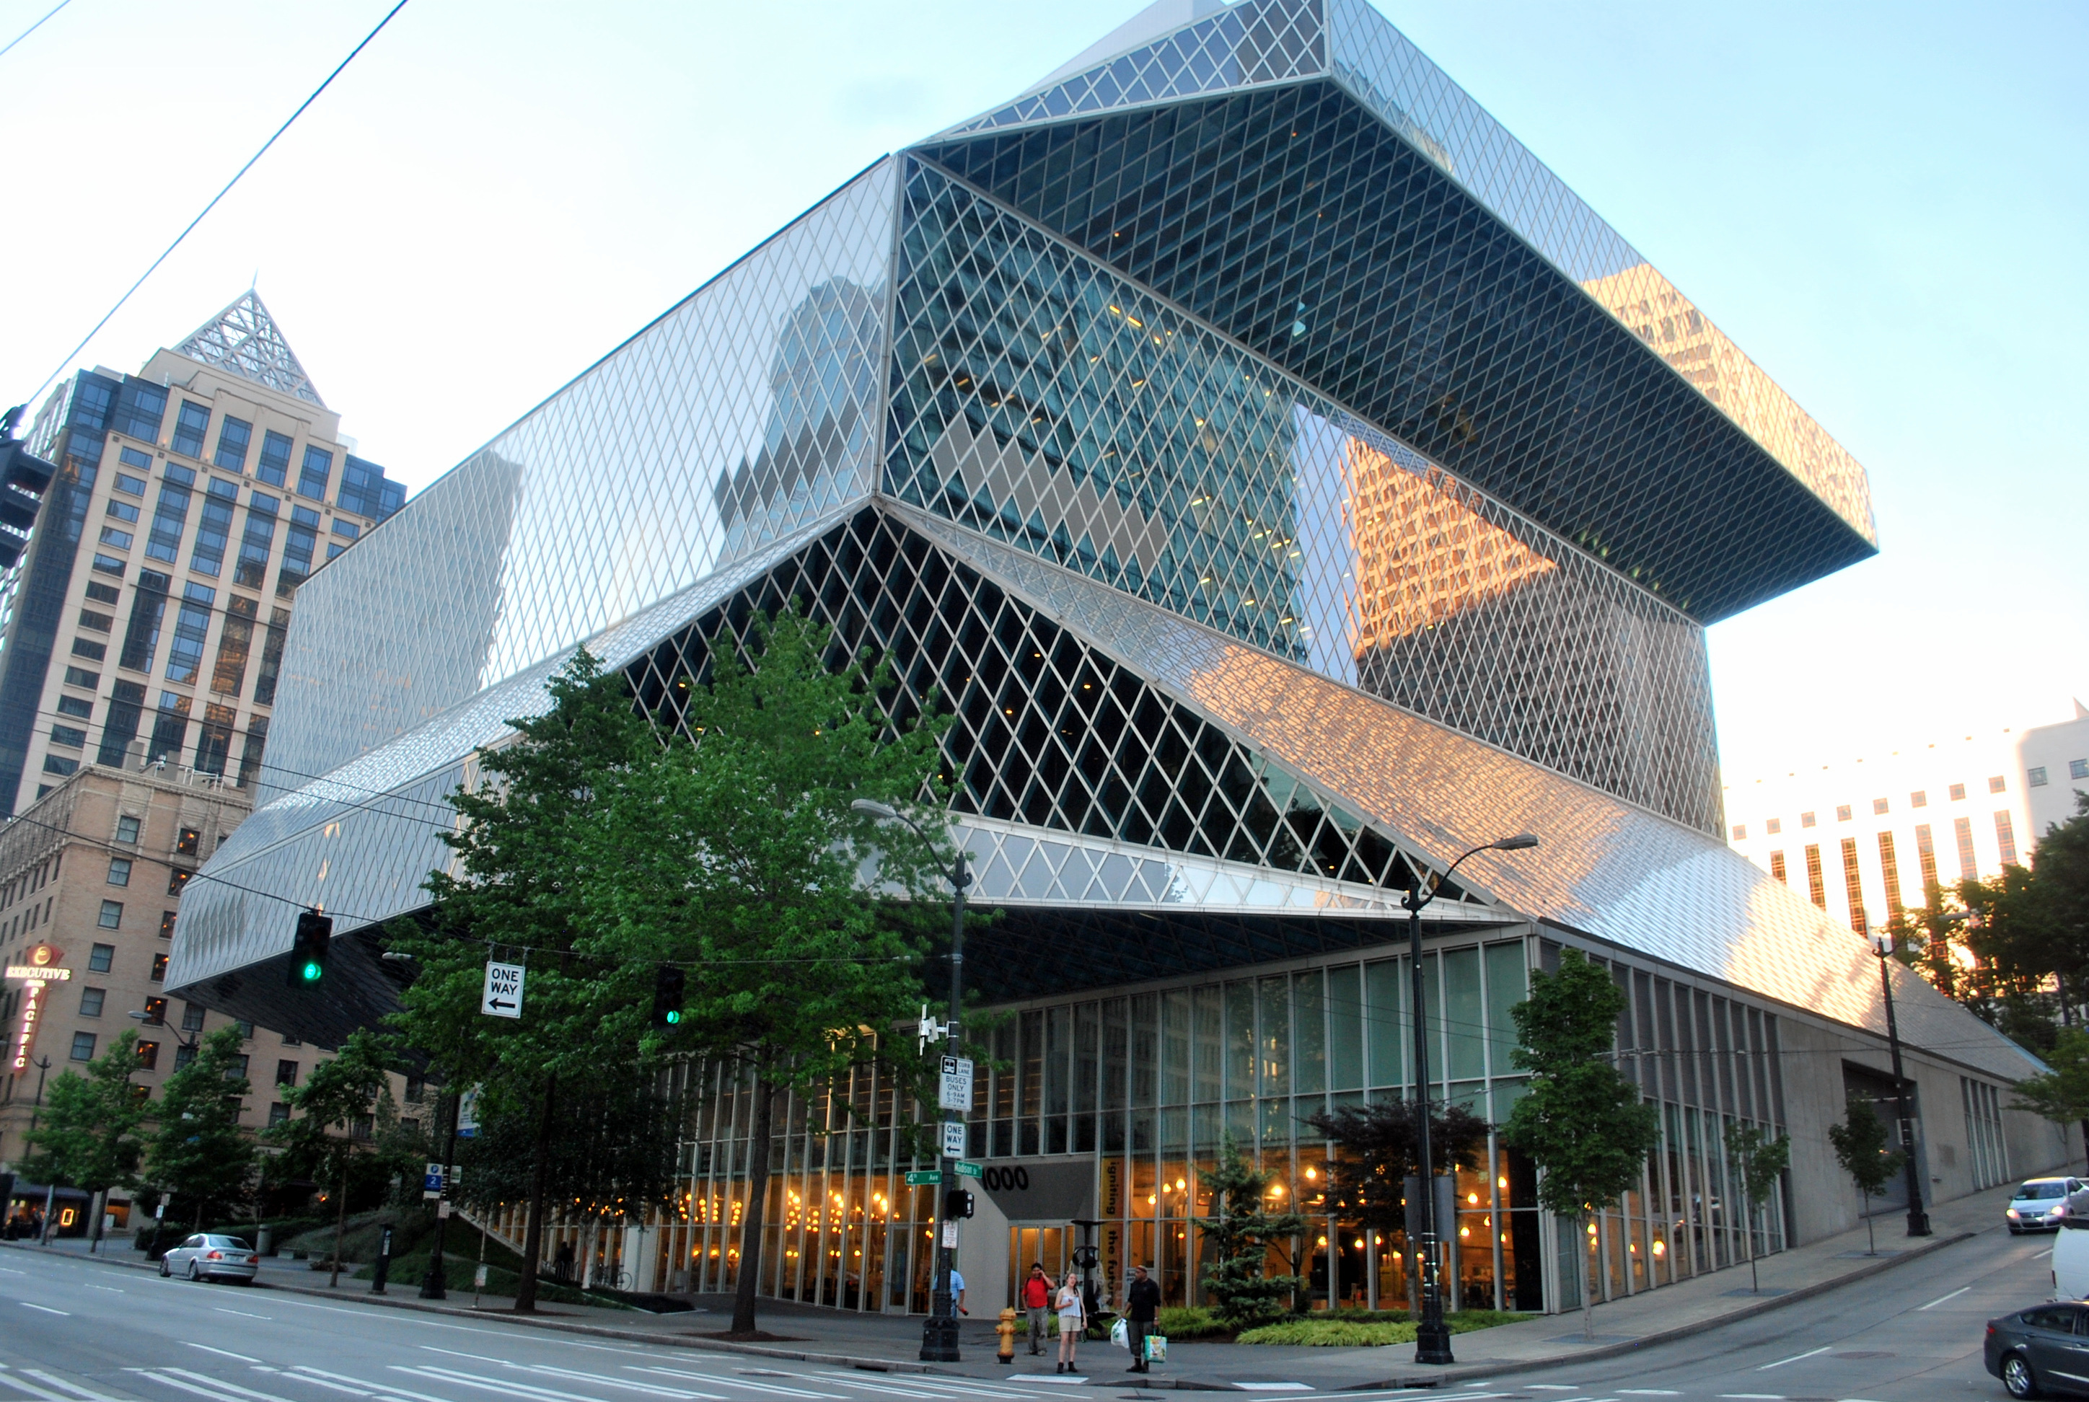
Notes:
Received a huge amount of media attention, became an icon of the city, and marked a new way of thinking about how to build a library for the 21st century.
It was revolutionary in 2 ways:
First, they designed for all media – not just books

Slide 13
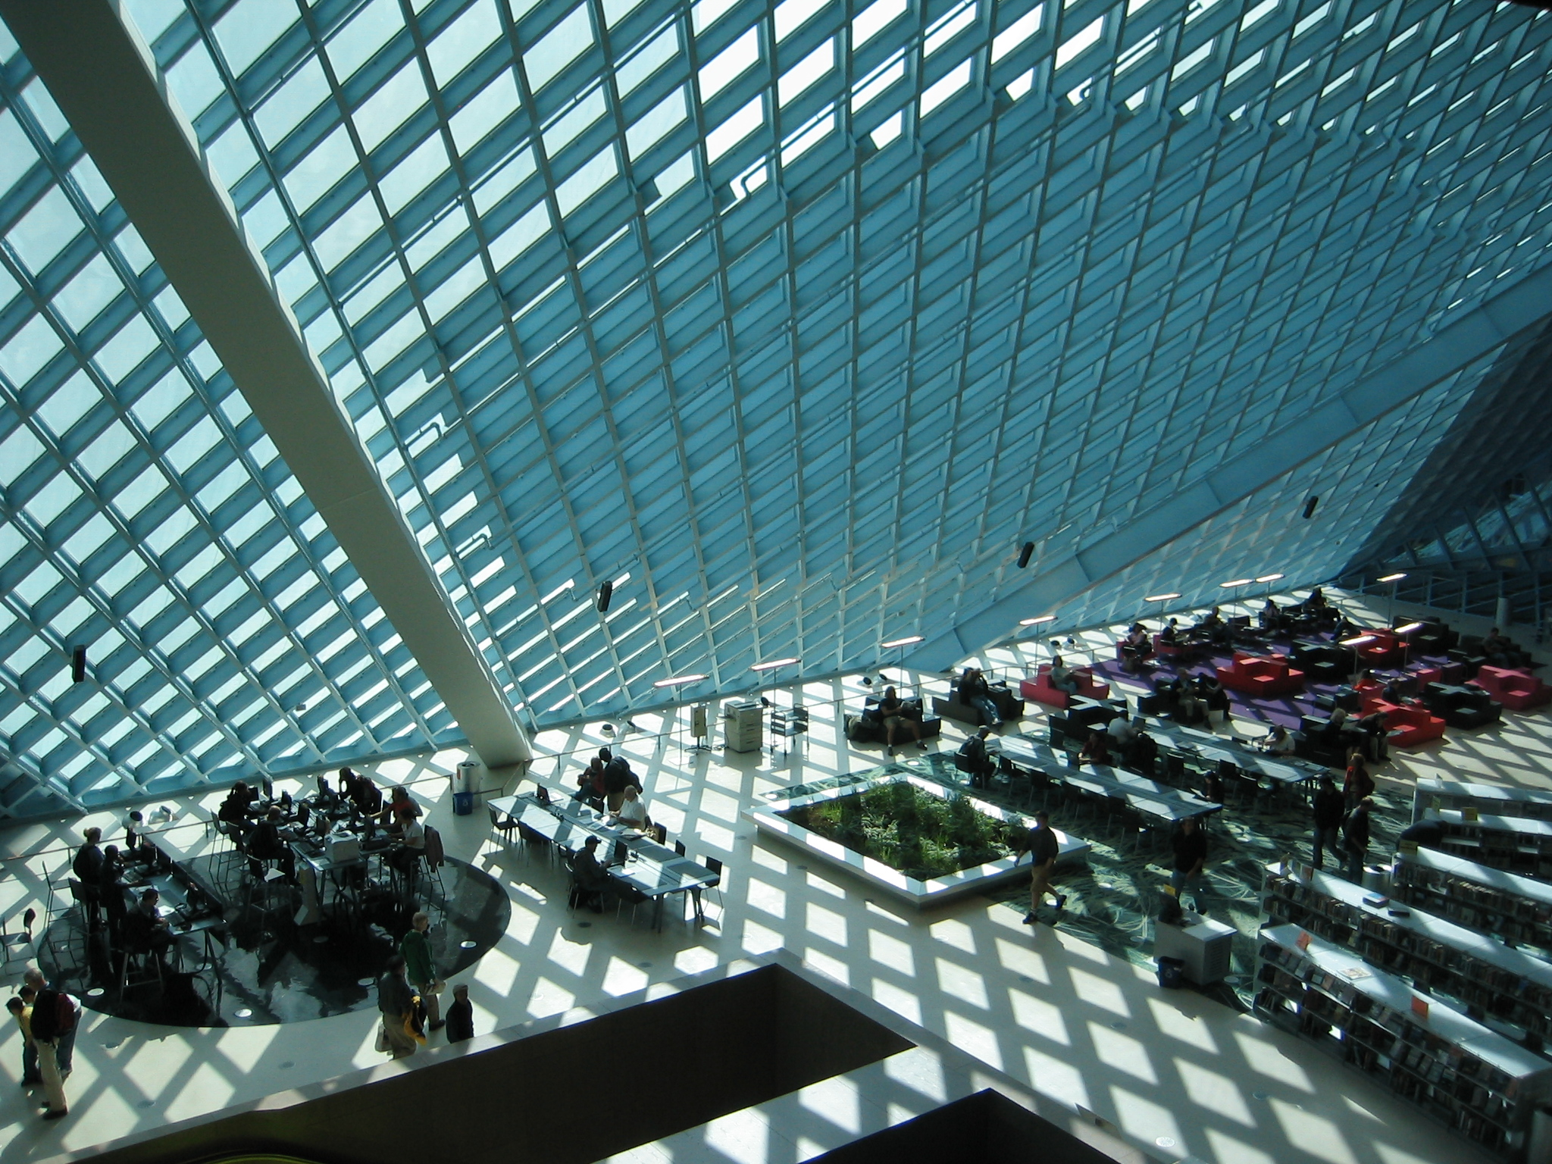
Notes:
The second way it was revolutionary was in the flexibility of space. Libraries that had been built in the late 1990s – in places like San Francisco, Denver, and Phoenix - used a plan where any activity could happen in any space of the library – supposed to be flexible, but in reality just kept adding materials and encroaching on public space. The program at Seattle created dedicated spaces emphasizing public space as important – they had the idea of creating a living room within the library – a space where people could just hang out, relax, read, and converse.

Slide 14
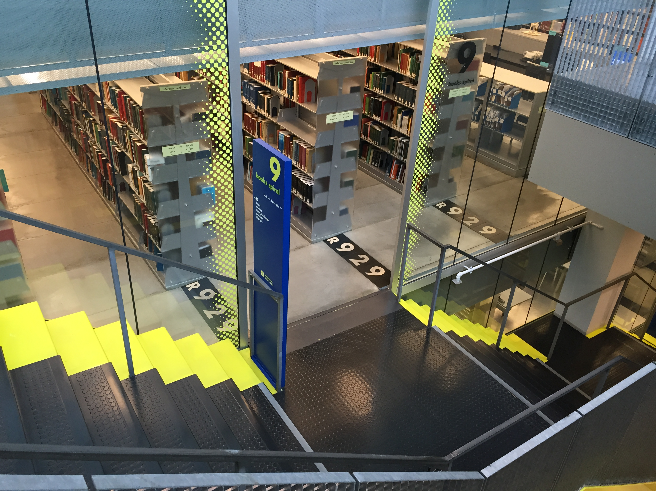
Notes:
The library was feeling overwhelmed by the proliferation of books plus new media, and the architects addressed this by looking at the collections and services at the library – they were all disparate, they couldn’t really see what they had, so the architects grouped them together into 5 programs or functions – this made plenty of space for the books, plus the additional services the library wanted to provide. They have what they call the mixing chamber, which is where reference is located and there are 120 computer stations. What you see in this picture is “The Book Spiral” – a continuous shelving unit – “parking garage of books” for nonfiction. Dewey Decimal numbers are painted on the floor to help with navigation.

Slide 15
McAllen Public Library
Location: McAllen, Texas
Architect: Meyer, Scherer & Rockcastle, Ltd.
Year: 2011
Notes:
The next example, McAllen Public Library in Texas is a suburban community on the Rio Grande river, very close to the border with Mexico.

Slide 16
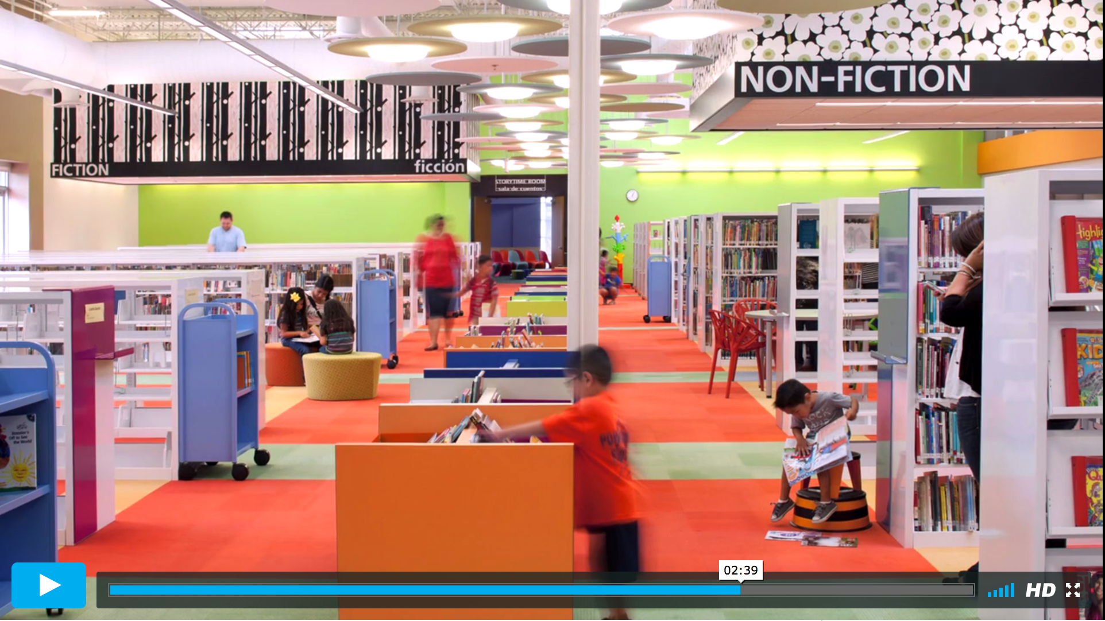
Notes:
This is an interesting case. They took an abandoned Wal-Mart store and converted it into a library.
They aimed to create a community gathering place but the challenge was creating intimate spaces within this enormous warehouse.
So they broke up the space into different areas – fiction, nonfiction, children’s – using distinct colors and labelling the sections with large signs – written in both English and Spanish.
They wanted the spaces to be flexible for the future – resources can’t anticipate using now, so that idea of flexibility from Seattle we see present here.
Previous space was dark, cramped, had limited seating. Now, the space is very light and airy with skylights. There is a quiet room, computer lab, a café, 30 small rooms for meetings or studying, an auditorium, and electronic classrooms.
The redesign was extremely effective for this community. The number of patrons more than doubled from the old building from 28,000 to 62,000 (NY Times).

Slide 17
Anacostia Public Library
Location: Washington DC
Architect: Perkins + Will
Year: 2010
Notes:
Moving on to Anacostia Public Library, this is a neighborhood branch of the Washington DC Public Library.

Slide 18
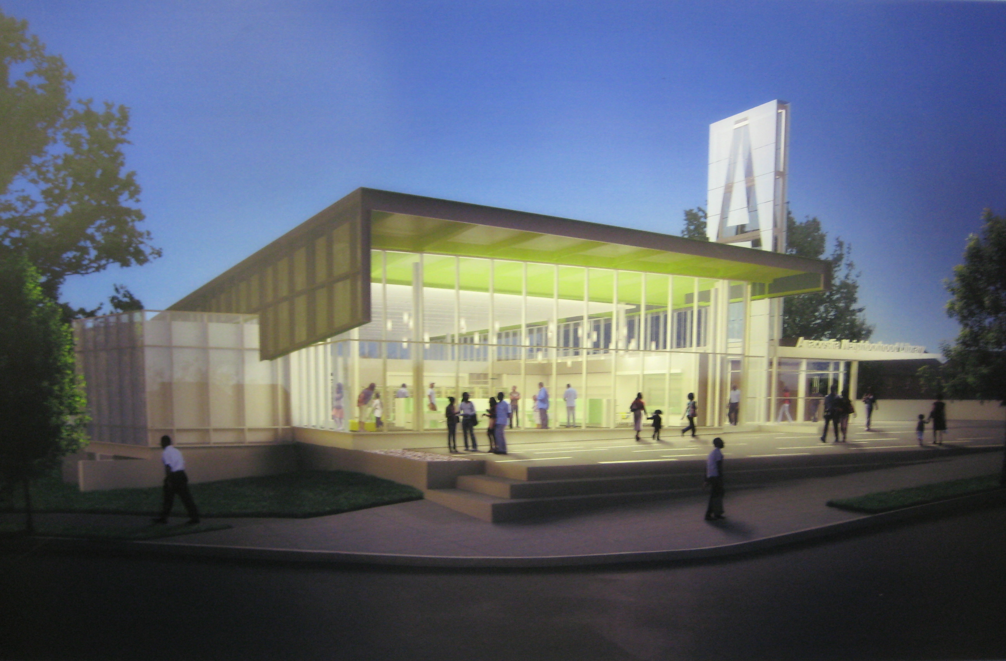
Notes:
Anacostia is a residential area with a lot of families. It’s a majority African American community and largely lower income. They used to have a library in the neighborhood, but it was torn down in the 1990s. So when the city launched this building project, their aim was to restore community pride and promote economic development. Community decided they wanted to put children at the forefront of the library – children’s area is first area when enter the library.
Lots of seating, reading room, public meeting rooms, separate teen area
Outdoor space very important – have large plaza for people to gather in, glass on all sides of the building to make inviting to people walking by to come in (Howard & Hill, 2017)

Slide 19
Chattanooga Public Library The Fourth Floor
Location: Chattanooga, TN
Year: 2013
Notes:
The final example is from Chattanooga Public Library. On a very small budget, they transformed attic storage space into incubator for artist projects, workshops, zine library, entrepreneur networking events. Completely flexible space, all furniture on castors. Chattanooga as a city has an emphasis on civic engagement. Library wanted to create a space for cultural production, a resource for tools to make things that could improve the community. Makerspace, 3D printer, a loom, sewing machines, power tools. They also emphasize entrepreneurship – wanted to create “equitable economic development.” Take the cool factor out of these types of events and make more accessible. Inviting people in to use the space how they wanted and giving them the skills training and tools to do so.
(Howard & Hill, 2017)

Slide 20
A 21st Century Library
What does it mean?
Notes:
We’ve seen some commonalities of these spaces: they focus on the needs of their specific communities:
In Chattanooga, it’s business development, technology, and education.
In Anacostia, it was putting the children of the community first.
In McAllen, it was important to serve immigrants to the US from Mexico.
And in Seattle, it was about creating public spaces for people to relax, read, and converse - the living room of the library.
I’d like to conclude with one last thought. I have focused my presentation on examples from the US, but the International Federation of Library Administrators at a conference last year had forum titled “What Comes After the Third Place?” If the idea of third place was guiding the principles of building libraries from the early 2000s until now, what’s next? A public library project in Aarhus, Denmark is having a big impact on the design of public libraries. Taking the idea of third place and not just applying it to the existing framework of the library but actively striving to make the library a third place. Aarhus Public Library is part of a cultural center being built with connections to public transportation, outdoor space, performance space, galleries - dubbed the “living room of the city.”
I’m not sure if this idea is really new or goes beyond the idea of third place, but seeing continued emphasis on providing other resources and services beyond the traditional idea of libraries for books to providing community space.

Slide 21
Thanks!
Any questions?

Slide 22
References
Feinberg, S. & Keller, J.R. (2010). Designing space for children and teens in libraries and public places. Chicago: American Library Association.
Horrigan, J. (2015). Libraries at the crossroads: Pew Research Center. Retrieved from: http://www.pewinternet.org/2015/09/15/2015/Libraries-at-crossroads/
Howard, Z. & Hill, N. (2017, March). Beyond books: Redefining the civic role of public libraries. Cooper Hewitt, New York, NY. Retrieved from: https://www.cooperhewitt.org/2017/03/09/beyond-books-redefining-the-civic-role-of-public-libraries/
Molz, R.K. & Dain, P. (1999). Civic Space/cyberspace: the American public library in the information age. Cambridge, MA: MIT Press.
Morehart, P. (2016). Moving beyond the “third place.” Retrieved from https://americanlibrariesmagazine.org/blogs/the-scoop/library-design-moving-beyond-third-place/
Oldenburg, R. (1989). The great good place. New York: Marlow.
OMA/LMN (1999). Seattle Public Library proposal. Retrieved from: http://www.spl.org/prebuilt/cen_conceptbook/page2.htm
Smith, S. (2012, September 2). Big-box store has new life as an airy public library. The New York Times. Retrieved from http://www.nytimes.com/2012/09/02/us/former-walmart-in-mcallen-is-now-an-airy-public-library.html

Slide 23
Credits
Photos:
Seattle Public Library
“Seattle Public Library, 8:30 PM 07.28.14” by Joe Wolf. Licensed under a Creative Commons Attribution-NoDerivs 2.0 Generic (CC BY-ND 2.0). Retrieved from https://www.flickr.com/photos/joebehr/14655895419
“Seattle Public Library on a sunny day” by Moody75 Licensed under a [CC BY-SA 2.0 (http://creativecommons.org/licenses/by-sa/2.0)], via Wikimedia Commons.
Retrieved from http://www.flickr.com/photos/moody75/48112462/
“The Seattle Public Library” by “The West End.” Licensed under a Creative Commons Attribution-NonCommercial-NoDerivs 2.0 Generic (CC BY-NC-ND 2.0). Retrieved from https://www.flickr.com/photos/thewestend/
22434747000/in/photolist-4jyc2e-yvMZC-cDL73W-cDL81A-oVz69-7MQdJ8-92pNqB-a3P7p6-AbtWEL-6CALKw-7BeUHb-7Bb6jK-4vfmxe-7BeVw7-vFwK8D-7BeVeu-yABsZ-6HeTSN-a2j8Ni-92pLZD-a3P7Gi-7BeUSN-7vkuA8-PSzkw-5aY5U1-tUzY-jkZUd-bwYLz-jkZUe-7EtvYj-rzXS8r
Anacostia Public Library
“anacostia neighborhood library at night” by “GarberDC.” Licensed under a Creative Commons Attribution-NoDerivs 2.0 Generic (CC BY-ND 2.0). Retrieved from https://www.flickr.com/photos/dg-rad/2575195523/
Presentation template by SlidesCarnival

