Slide 1
Conservation and Curation of the
Pratt School of Information Archives
#infoshow 2016

Slide 2
Conservation

Slide 3
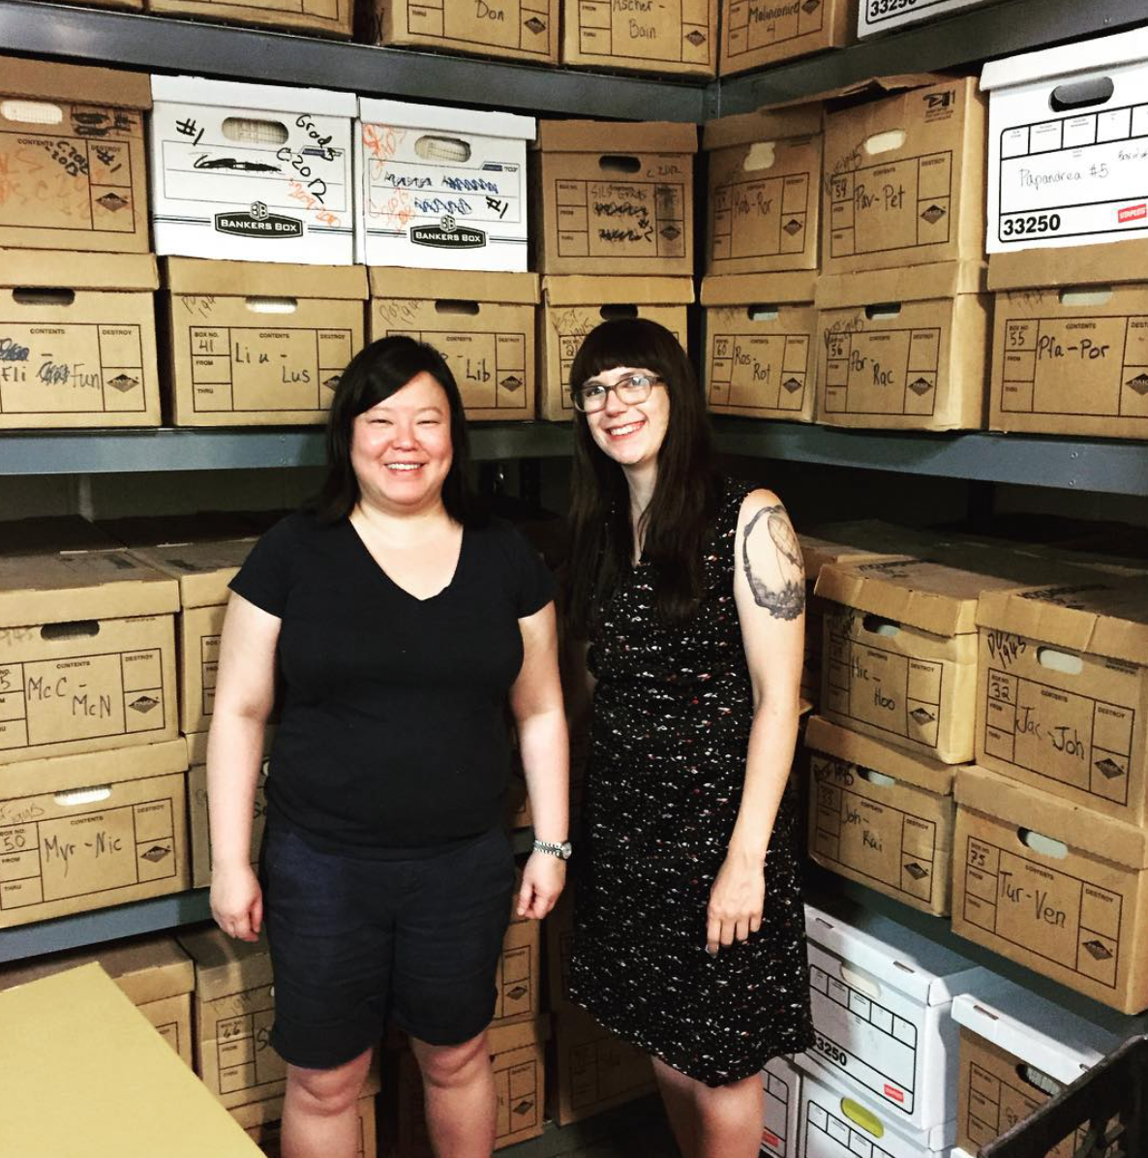
About the collection
10 boxes (10 linear feet) pulled from the PMC basement
Bulk dates: early 1960s - late 1980s
A variety of School of Information student records, administrative records, personnel files, and comparable documents
Quite different from the work done in Fall 2015, processing primarily pre-1945 documents!

Slide 4
Conservation Overview
The documents in need of conserving were from the turn of the twentieth century (1890-1901)
A majority of the documents conserved were course schedules.
Conservation team identified 28 documents that were in need of humidifying and flattening.
Ultimately, only 26 documents were humidified and flattened. The two documents left out of the process were deemed too fragile.

Slide 5
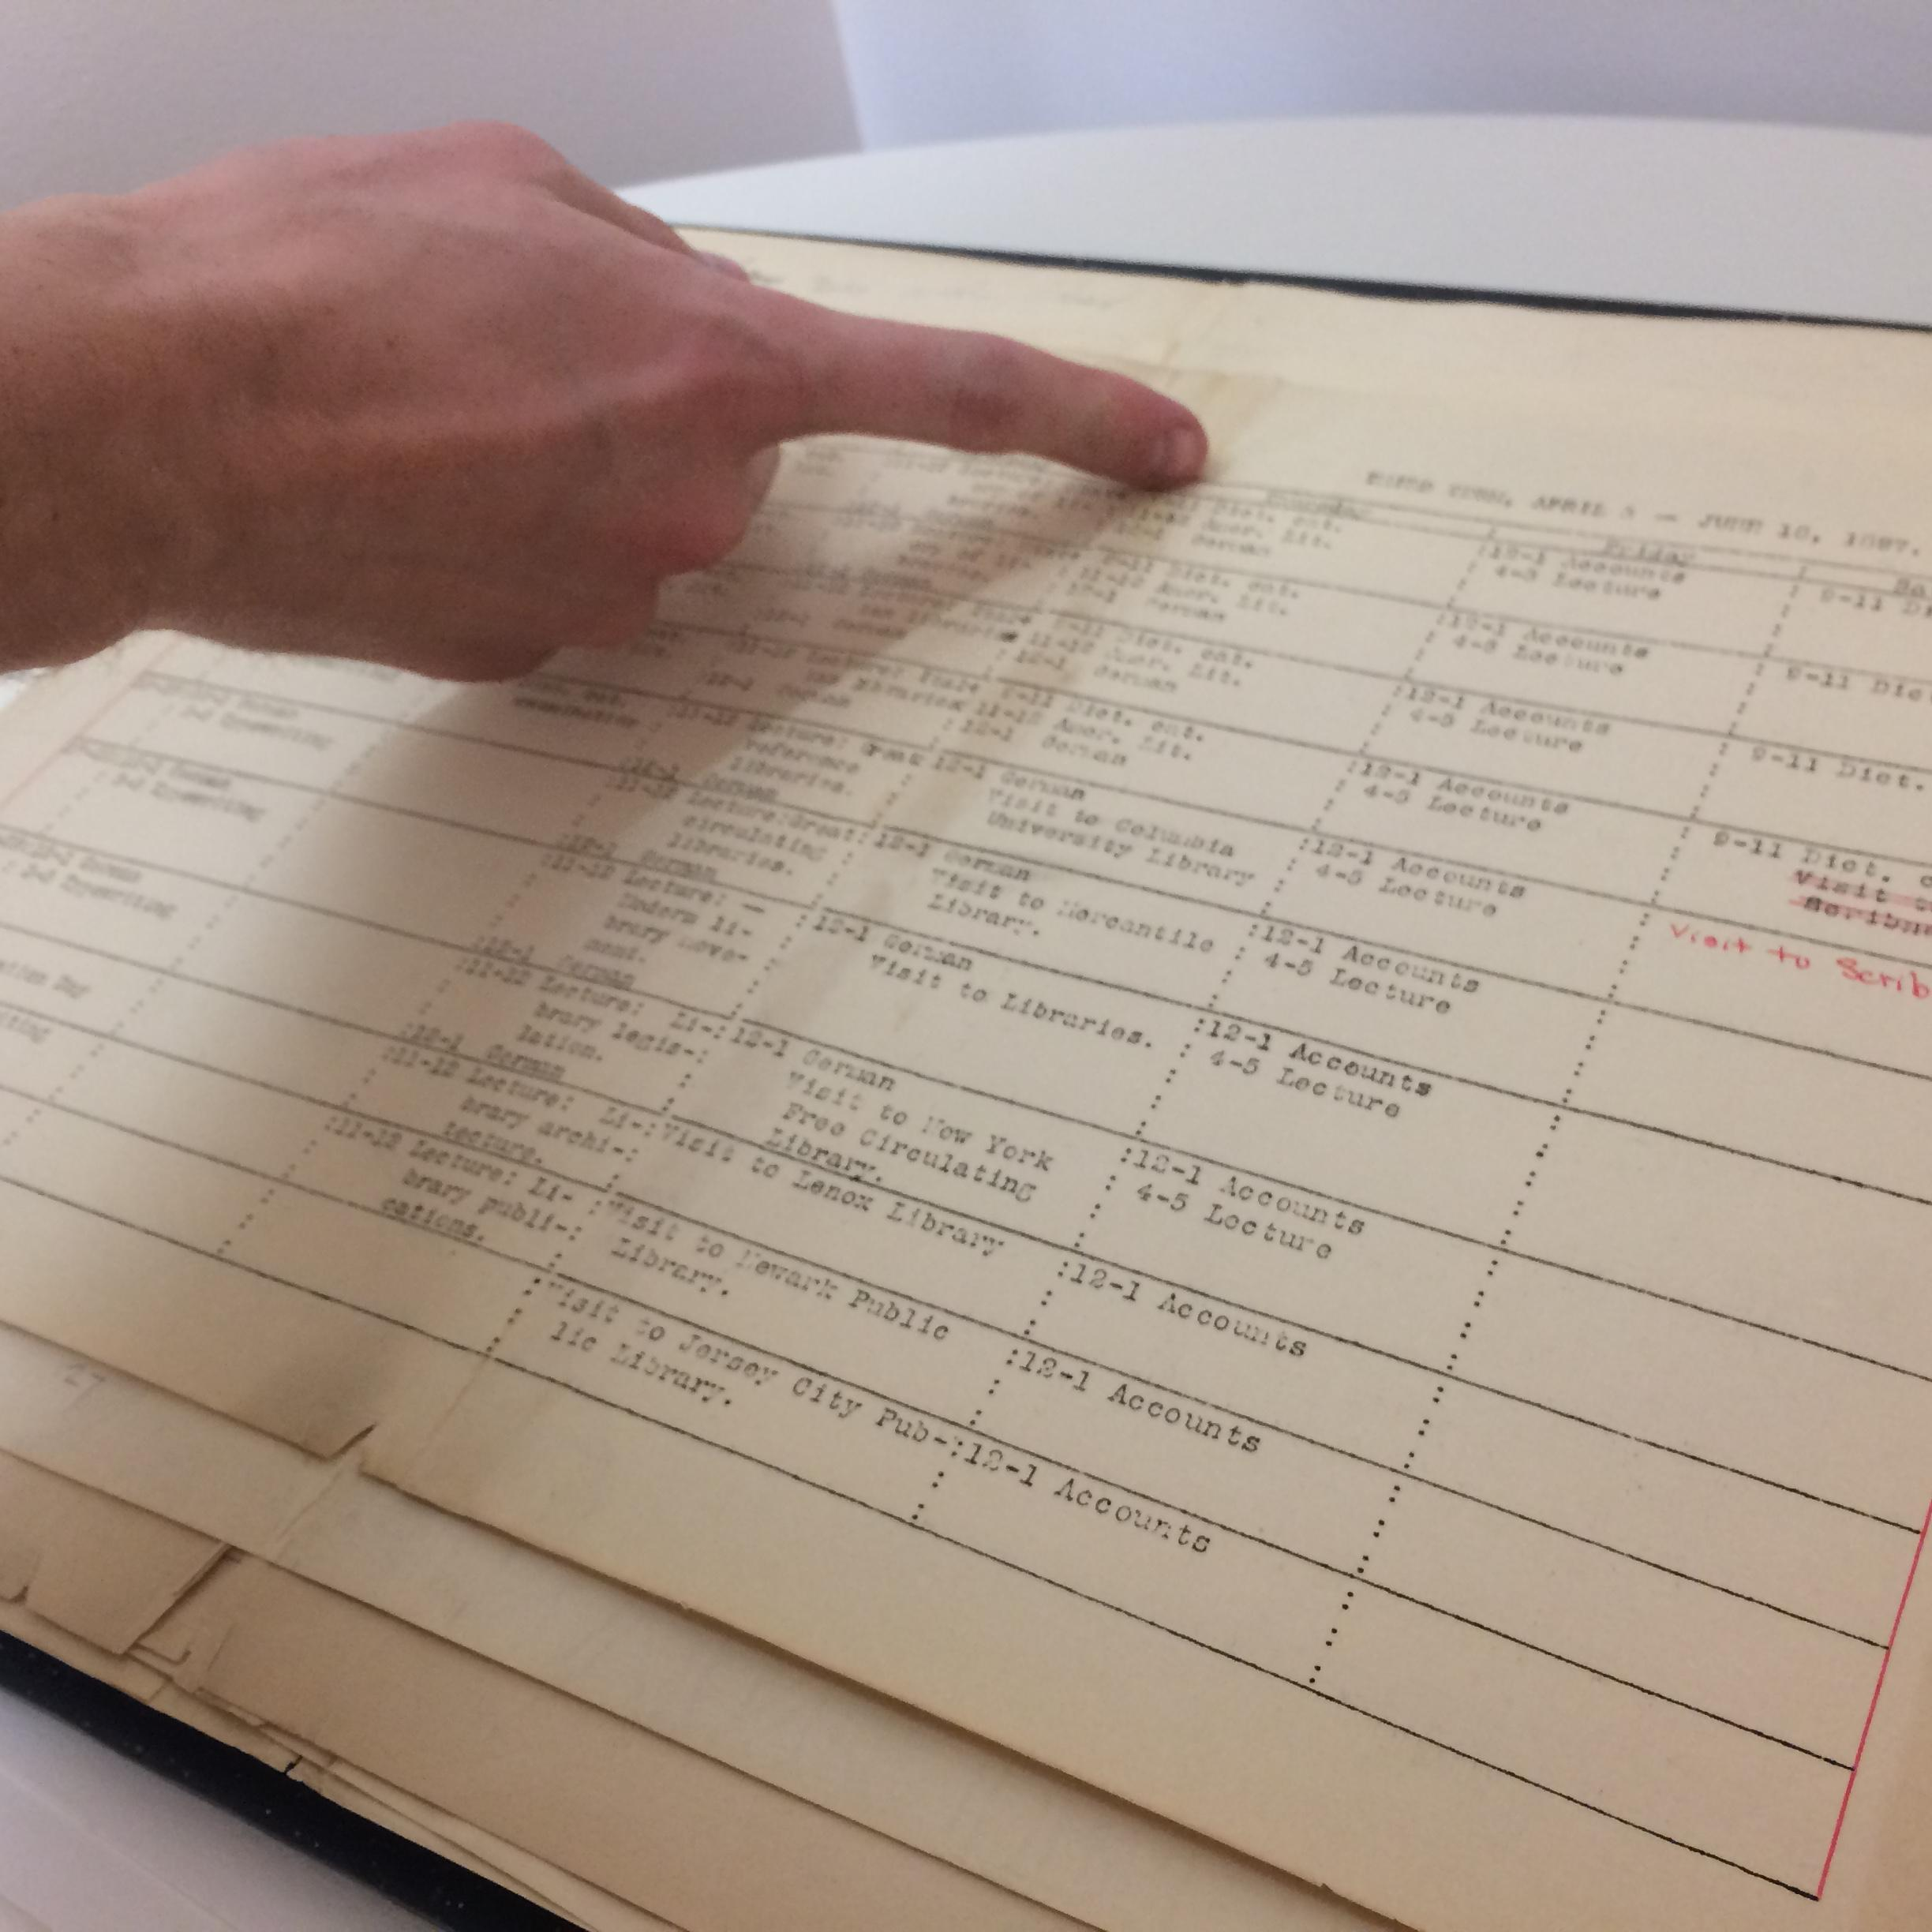
Conservation Concerns
Adhesive
Tape and glue presented fears about running and damage to nearby documents
Fasteners
Pins and staples needed to be removed from old and brittle documents
Flattening large folded documents
26 documents were humidified and flattened, enclosed in Mylar, and rehoused in large flat boxes

Slide 6
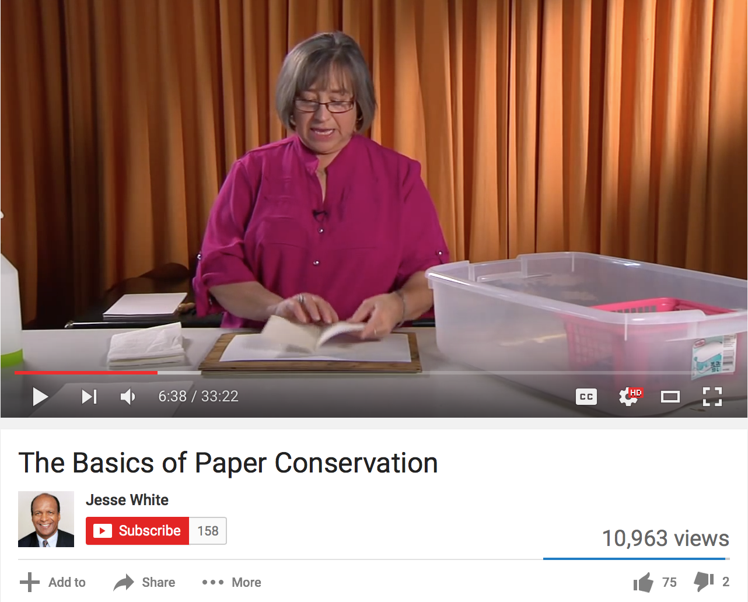
Constructing a humidification chamber
Watertight plastic tub with snap on lid
Damp towel (placed on bottom of tub)
Metal tray (placed upside down to serve as a stand)
Plastic basket on top of the tray to hold documents
https://www.youtube.com/watch?v=dcb3JwPjDjA

Slide 7
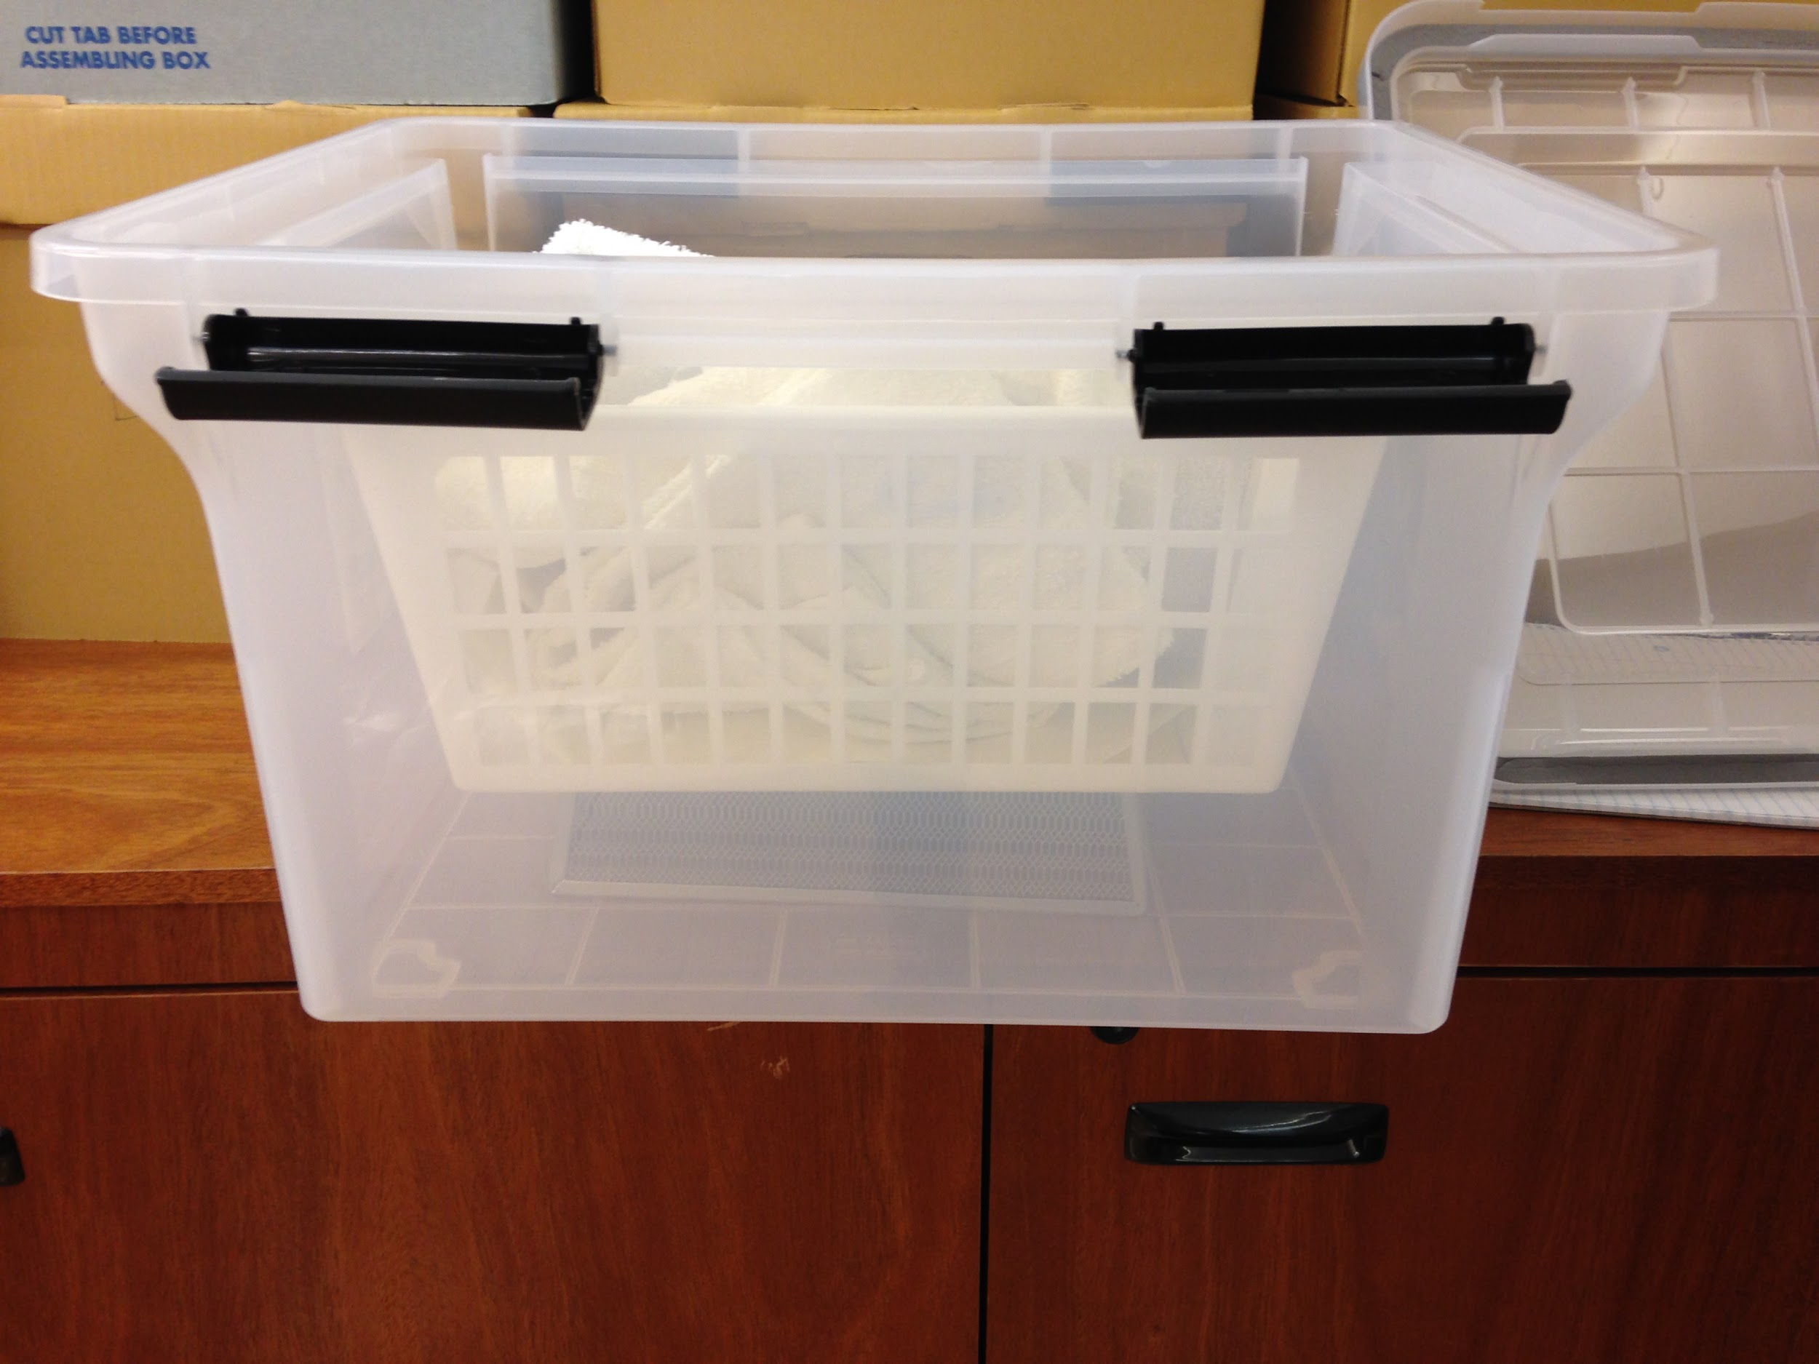
Using the Humidification Chamber
Started with test runs - humidity stabilized at about 80-90 percent
Documents humidified in 2 batches, for 7 hours each
Documents then removed, flattened, and placed between blotting paper and cutting boards
No damage to any of the documents!

Slide 8
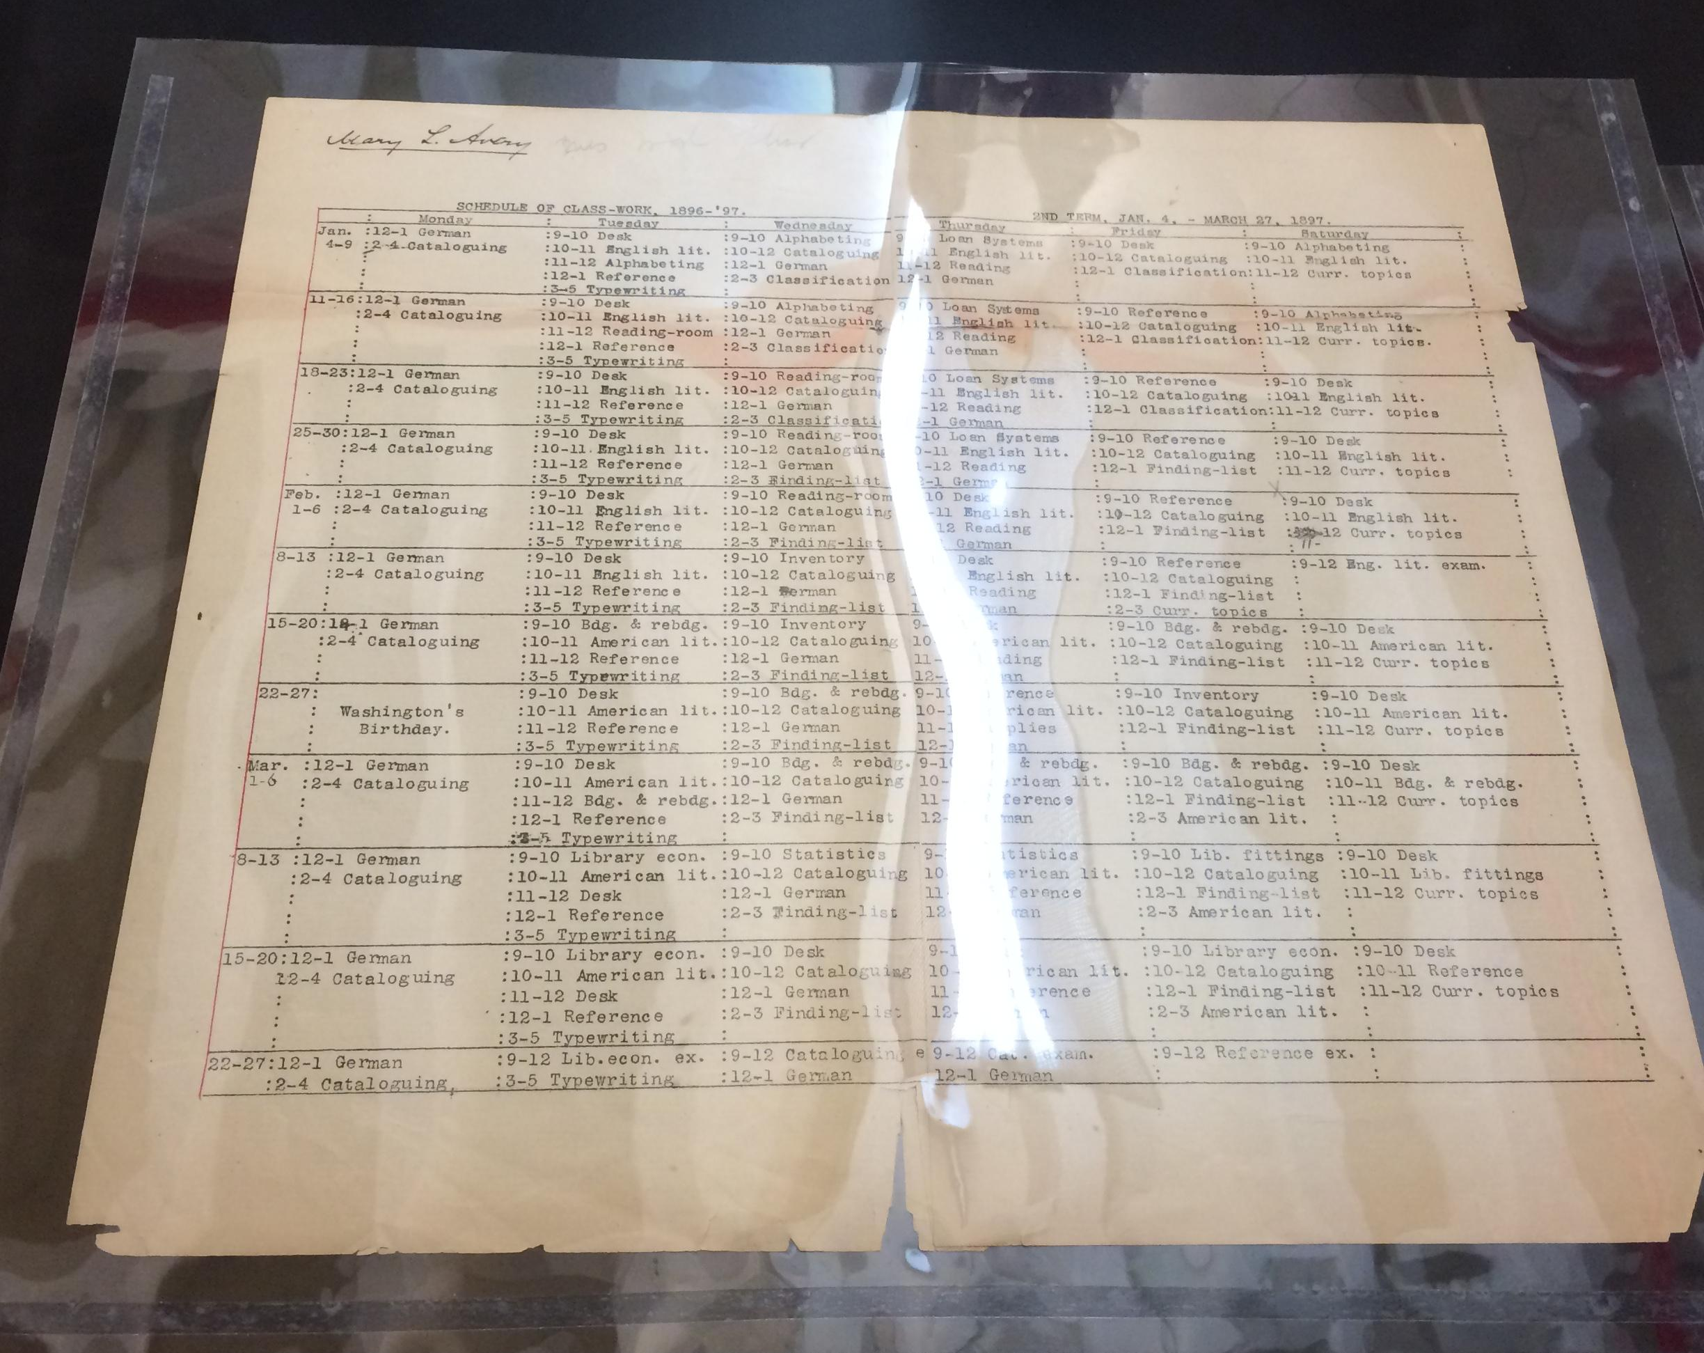
After humidification - Mylar!
After humidification, brittle pages were carefully unfolded
The team carefully encapsulated 15 of the documents - pages with breakage or large tears - in Mylar enclosures
Used large sheets of mylar and cut the cases to the right dimensions
Practiced using book weights, a cutter, board, archival tape, and bone folders

Slide 9
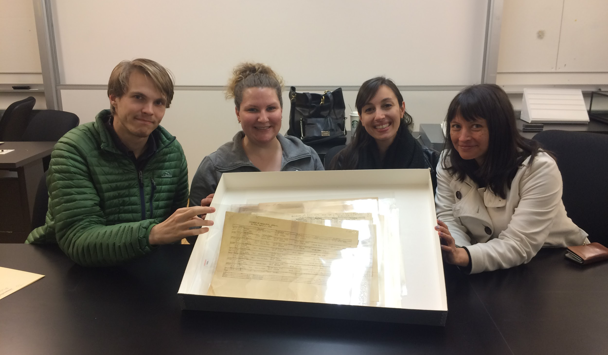
The final step
The documents were placed in a flat box and will be triumphantly returned to the Pratt Archives in Brooklyn

Slide 10
Curation & Exhibition

Slide 11
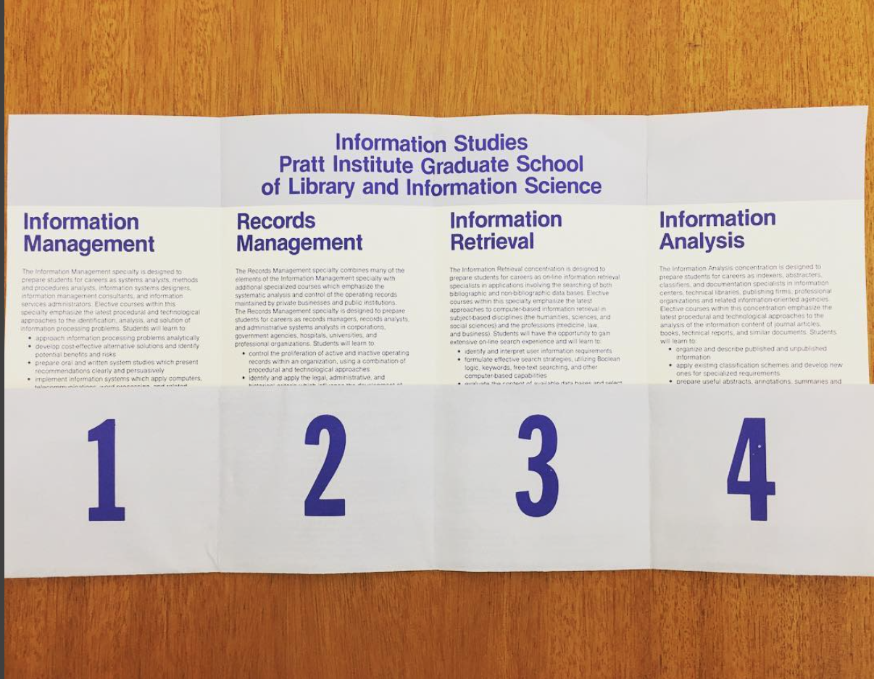
Curation and Exhibition
Exhibit theme: Developments in the School’s focus and mission, late 1960s - early 1980s/Pratt’s evolving relationship with computer technologies
An emphasis on:
Technology & computer science
School name changes

Slide 12
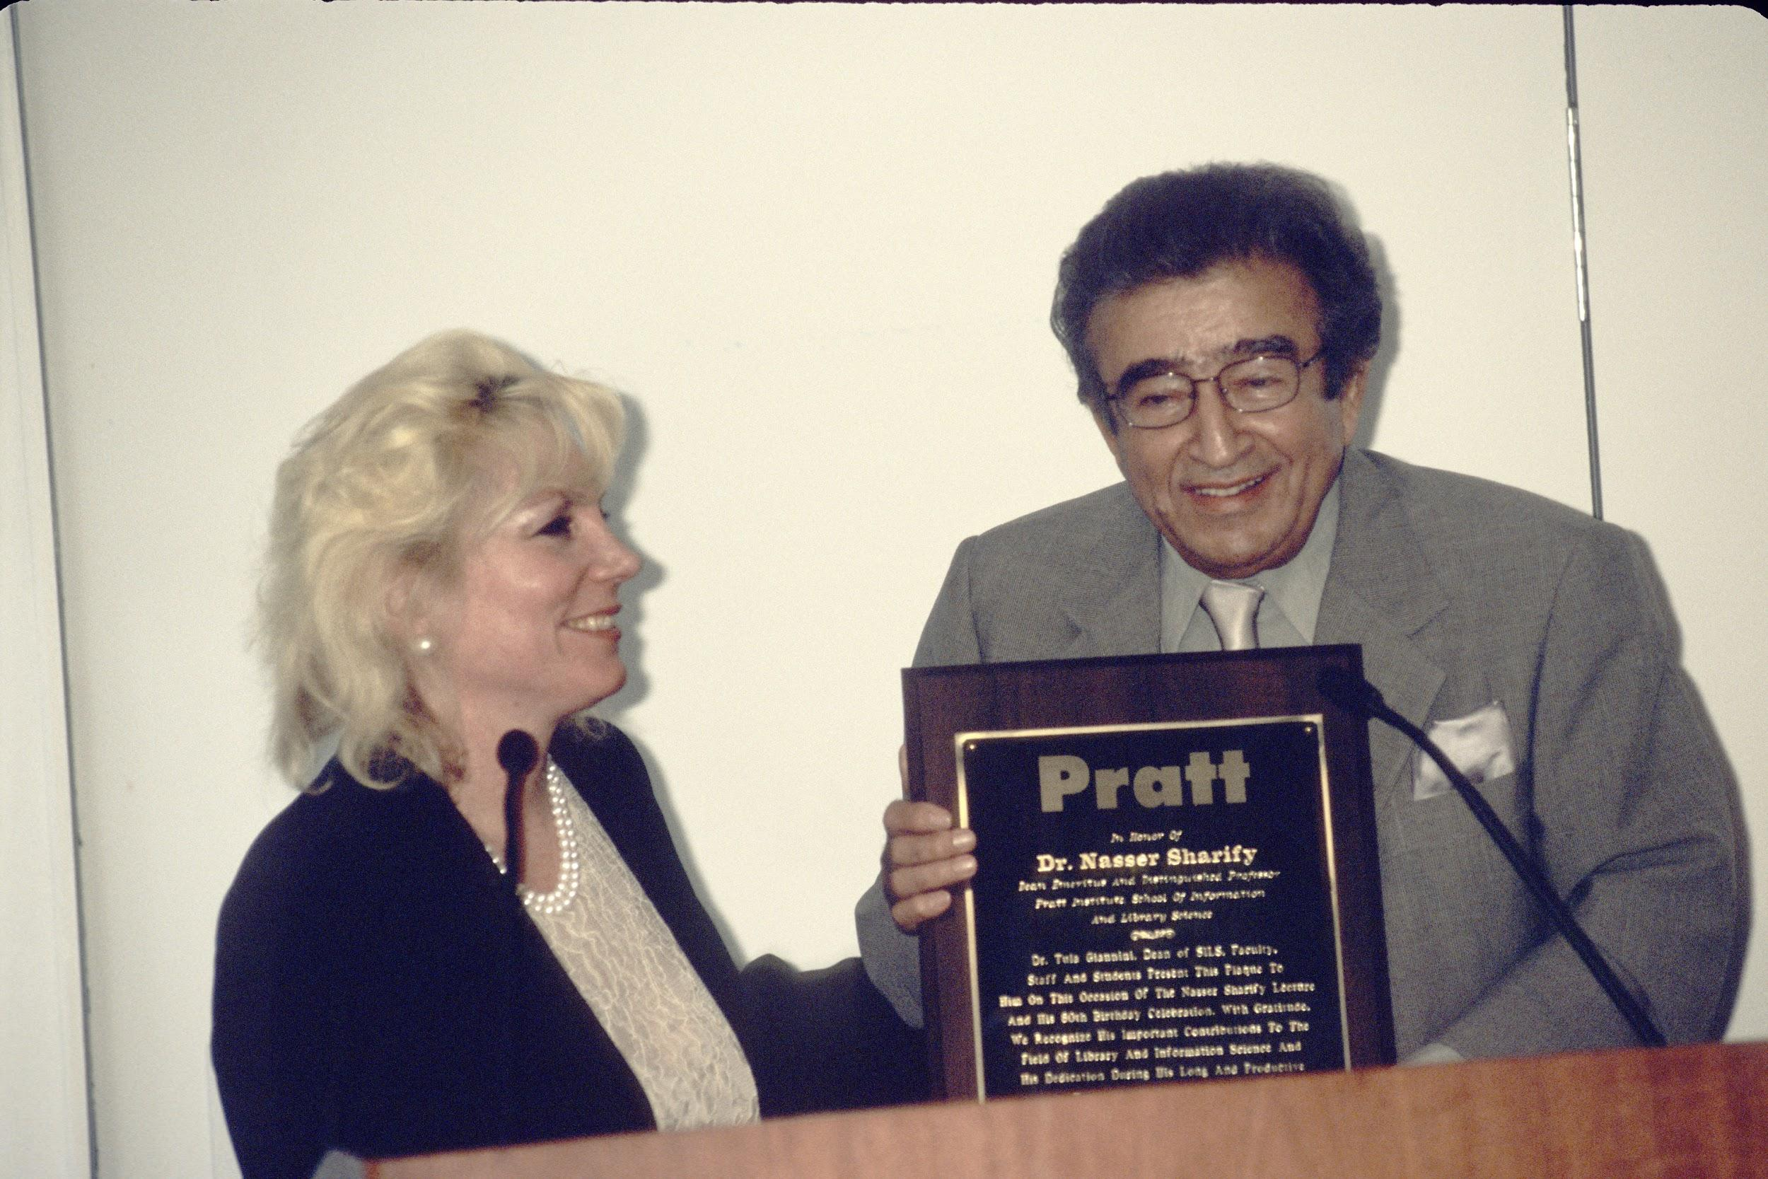
Pratt Institute late 1960s - late 1980s
Nasser Sharify, Dean of Pratt’s Library School from 1968 - 1987
Instrumental in establishing the school as a leader in hands-on technological librarian education
Dean Giannini presents a plaque recognizing Dr. Sharify's achievements on the occasion of his 80th birthday celebrated at the 18th Annual Sharify Lecture (2007).

Slide 13
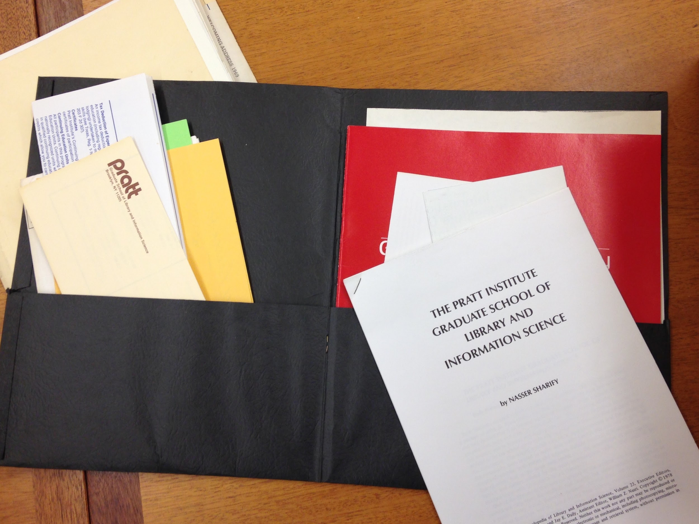
Materials for Exhibition
Course catalog from 1975-1976 academic year
Floor plan of the computer lab
Records concerning ALA conditional accreditation decision
An ongoing mystery - why did the merger of computer science and library programs fail?

Slide 14
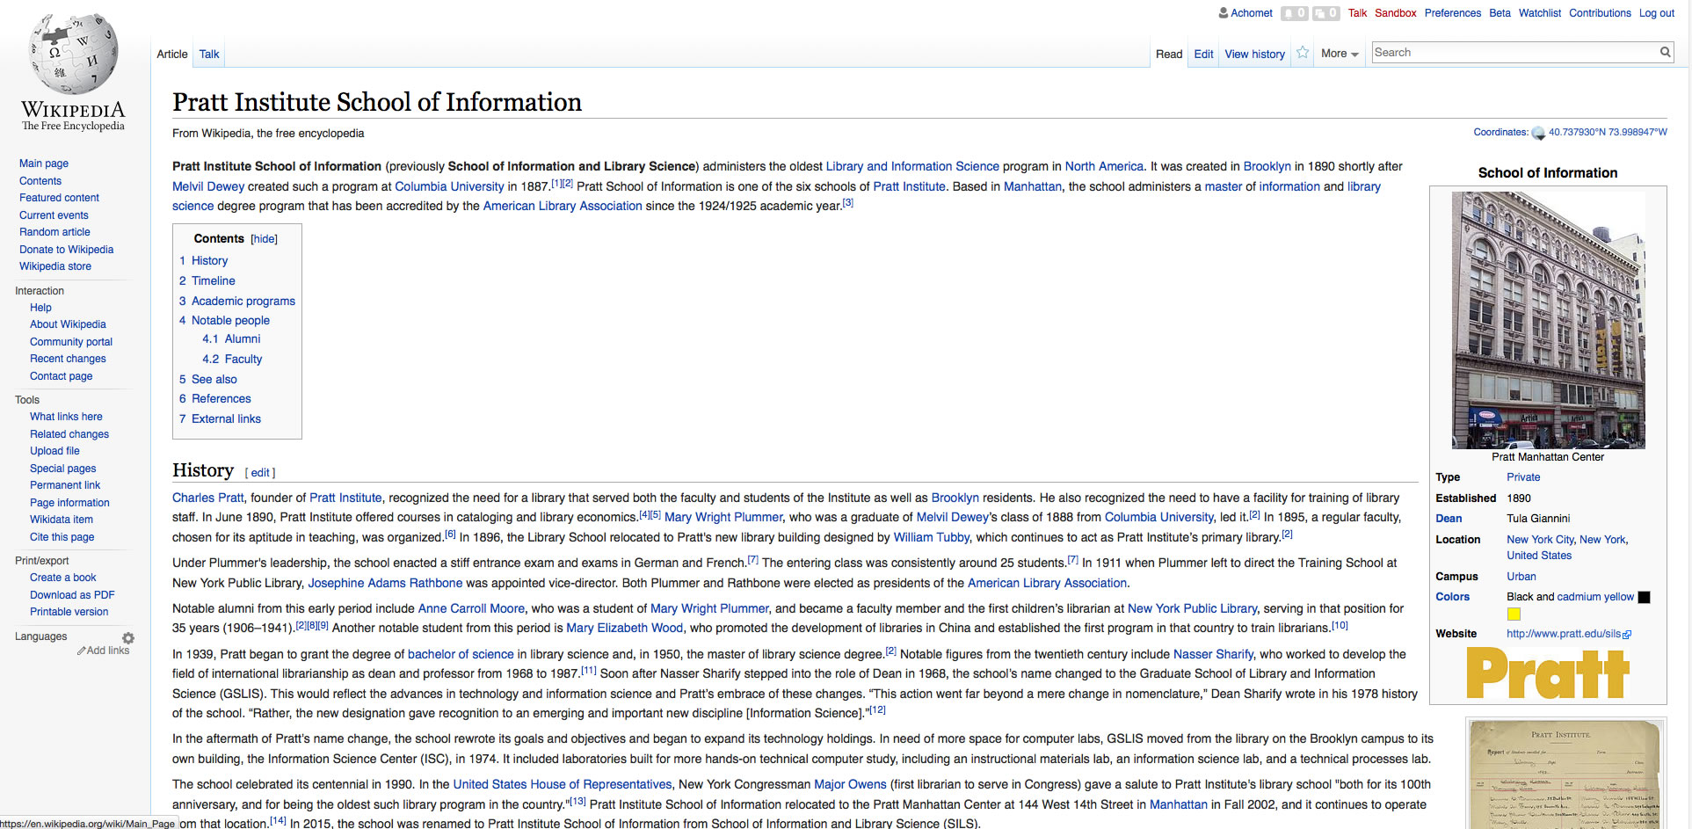
Wikipedia Edits
Changes to:
Pratt School of Information page: Timeline and History
Puck Building page
Nasser Sharify page

Slide 15
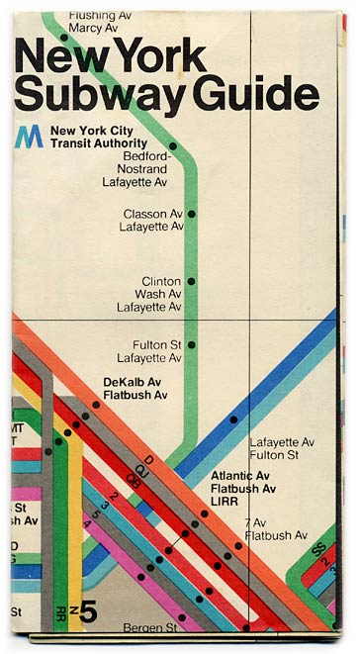
Exhibit Inspiration
Massimo Vignelli’s 1972 MTA Subway Guide
Giancarlo Iliprandi’ Poster for Arflex furniture company, 1970

Slide 16
Timeline of School Name Changes

Slide 17
Final Exhibit Design
Inspired by 1970s graphic design
Illustrations from a poster highlighting the “Urban Librarianship” program
Photos taken inside the Puck Building for a brochure advertising merger of computer science/library programs

