Slide 1
The Benefits of integrating folksonomy based systems in the public librarY
#longesttitleever
Kaitlin Kehnemuyi
May 15, 2015

Slide 2
Library 2.0 & Folksonomies
Library 2.0 encourages user participation through engagement in physical and virtual services
Folk + Taxonomy = Folksonomy aka User Tags, or Hashtags
A 2006 Pew Internet & American Life Project found that 28% of internet users
have tagged and that 7 percent of internet users say that they use tags daily.

Slide 3
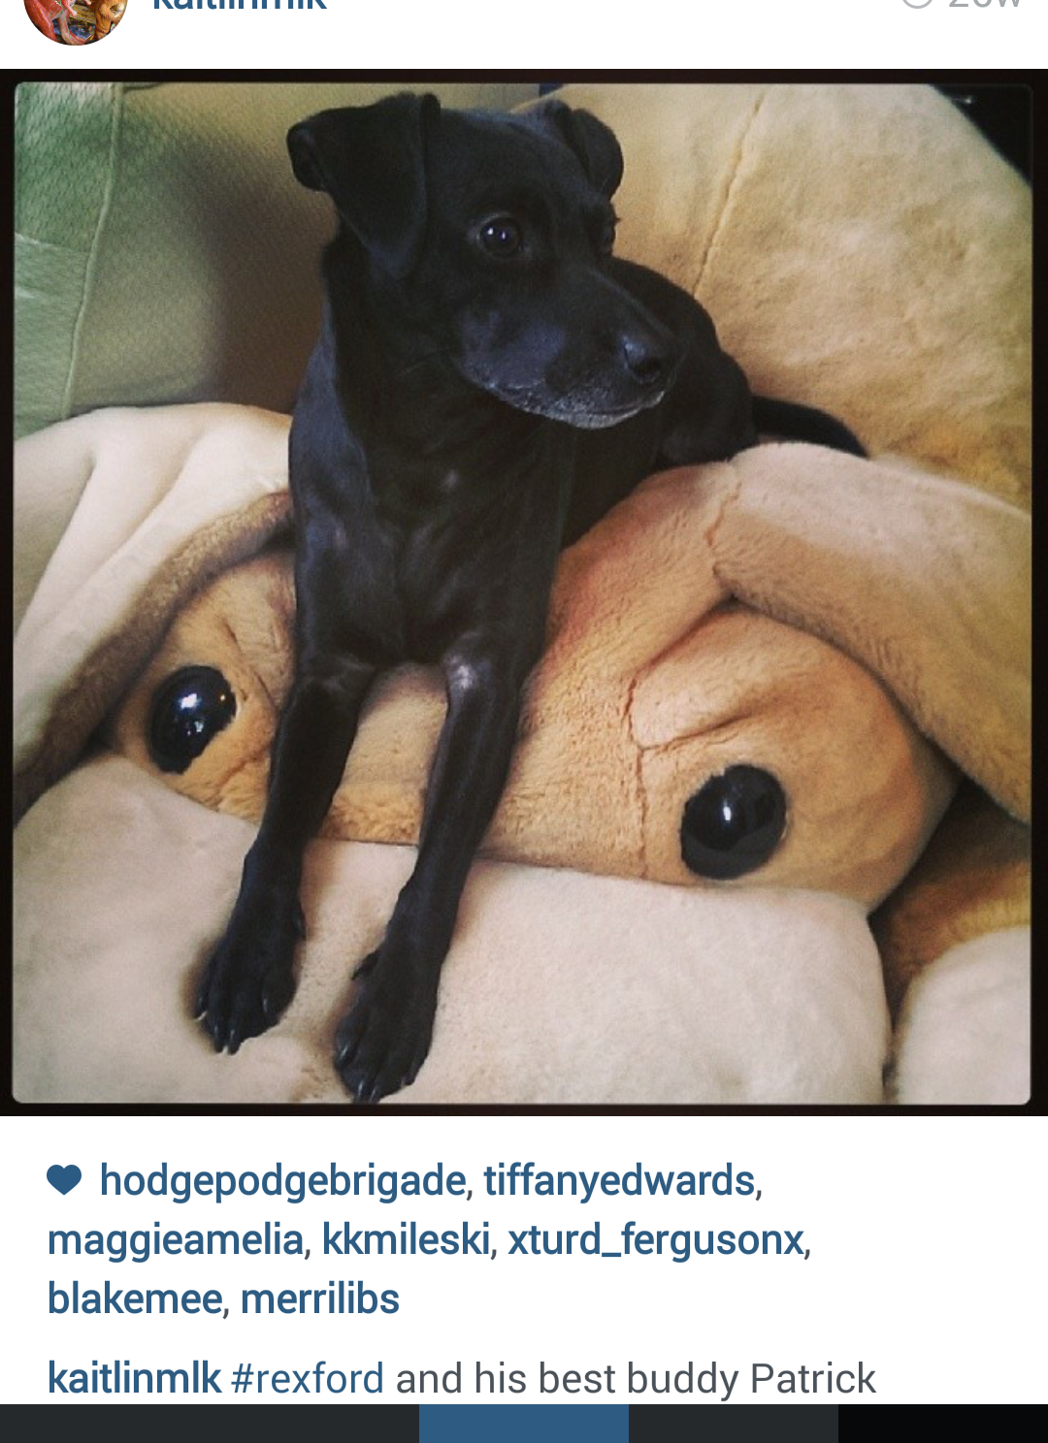
No Controlled Vocabulary
Both these photos are labeled “Rexford”
But what if instead of thinking of user tags as classification tools we started thinking of them as tools to help sort and curate content for patrons?
@kaitlinmlk
@wadech

Slide 4
Better search options in Opacs
All these tags relate to the content/themes in Charlotte’s Web. Tags can lead patrons to similar books.
Spokane County Library District Catalog, http://www.scld.org/

Slide 5
Make Services Accessible from home
Patrons are accessing information from our websites from home as well as our physical locations. Pinterest and Delicious allow libraries to organize information for patrons online.
Jersey City Free Public Library Downloadable Ebooks Board, https://www.pinterest.com/jerseycityPL/downloadable-ebooks/

Slide 6
Patron Engagement
You can use these platforms as additional ways for patrons to engage with the library and to help curate materials for the library.
Harrison Public Library HPL Books, etc Board: https://www.pinterest.com/harrisonpl/hpl-books-books-and-more-books/

Slide 7
Happy #bookfaceFriday!
@mlufk829
@angelicatibbling
@cafejavajanis

Slide 8
References
Bates, J., & Rowley, J. (2011). Social reproduction and exclusion in subject indexing: A comparison of public library OPACs and LibraryThing folksonomy. Journal of Documentation, 67(3), 431-448.
Boter, J., & Wedel, M. (2005). User categorization of public library collections. Library & Information Science Research, 27(2), 190-202.
Casey, M. E., & Savastinuk, L. C. (2006). LIBRARY 2.0. Library Journal, 131(14; 14), 40-42.
East Brunswick Public Library (n.d.). Retrieved November 15, 2014, from http://www.ebpl.org
East Brunswick Public Library :: Recommended Websites: The Best of the Web. (n.d.). Retrieved November 15, 2014, from http://www.ebpl.org/main/polDocClass.cfm
Elmborg, J. (2006). Libraries in the contact zone: On the creation of educational space. Renaissance Quarterly, 46(1), 56-64.
Furner, J. (2009). Folksonomies. Encyclopedia of Library and Information Sciences (Third Edition ed., pp. 1858-1866). New York: Taylor and Francis.
Jersey City Public Library (n.d.). Retrieved November 15, 2014, from http://www.jclibrary.org
Kroski, E. (2005). The hive mind: Folksonomies and user-based tagging. Retrieved from http://infotangle.blogsome.com/2005/12/07/the-hive-mind-folksonomies-and-user-based-tagging/
Mannes, J. (2006). Library 2.0 theory: Web 2.0 and its implications for libraries. Retrieved from http://www.webology.org/2006/v3n2/a25.html

Slide 9
References
Muncie Public Library (muncielibrary). (n.d.). Retrieved November 15, 2014, from http://www.pinterest.com/muncielibrary/
Rainie, L. (2007). 28% of online americans have used the internet to tag content. Pew Internet and American Life Project. January 31, 2007
Rethlefsen, M. L. (2007). Tags help make libraries del.icio.us. Library Journal, 132(15; 15), 26-28.
Sanders, D. (2008). Tag--you're it! American Libraries, 39(11), 52-54.
Spiteri, L. F. (2007). The structure and form of folksonomy tags: The road to the public library catalog. Information Technology and Libraries, 26(3), 13-25.
Steele, T. (2009). The new cooperative cataloging. Library Hi Tech, 27(1), 68-77.
Stephens, M., & Collins, M. (2007). Web 2.0, library 2.0, and the hyperlinked library. Serials Review, 33(4), p253.
Terdiman, D. (2005, February 1). Folksonomies tap people power. Wired, Retrieved from http://archive.wired.com/science/discoveries/news/2005/02/66456?currentPage=all
Xu, C., Ouyang, F., & Chu, H. (2009). The academic library meets web 2.0: Applications and implications. Journal of Academic Libraries, 35(no. 4), 331.
Yamaba, H., Tanoue, M., Takatsuka, K., Okazaki, N., & Tomita, S. (2013). On a serendipity-oriented recommender system based on folksonomy and its evaluation. Procedia Computer Science, 22, 276-284.
Yi, K., & Chan, L. M. (2009). Linking folksonomy to Library of Congress subject headings: An exploratory study. Journal of Documentation, 65}(6}), 872-900}.

Slide 10
IMAGES
Instagram:
https://instagram.com/angelicatibbling
https://instagram.com/cafejavajanis
https://instagram.com/kaitlinmlk/
https://instagram.com/mlufk829
https://instagram.com/wadech
Websites:
Harrison Public Library Pinterest https://www.pinterest.com/harrisonpl/hpl-books-books-and-more-books/
Jersey City Free Public Library Pinterest https://www.pinterest.com/jerseycityPL/downloadable-ebooks/
Spokane County Library District, http://www.scld.org/

