Slide 1
Trends in the Information Economy
Lauren Restivo
15 May 2014

Slide 2
Agenda
The Information Economy
Measuring Input and Output in Knowledge Industries
Knowledge Spillovers and Innovation
Consumer Surplus as an Alternative Metric

Slide 3
The Information Economy

Slide 4
Keywords
Productivity: output/input
Output: the number of items produced
Labor productivity: output/hour worked
Standard of living: output/person

Slide 5
Examples
The New York Times
Google
The Internet and YouTube

Slide 6
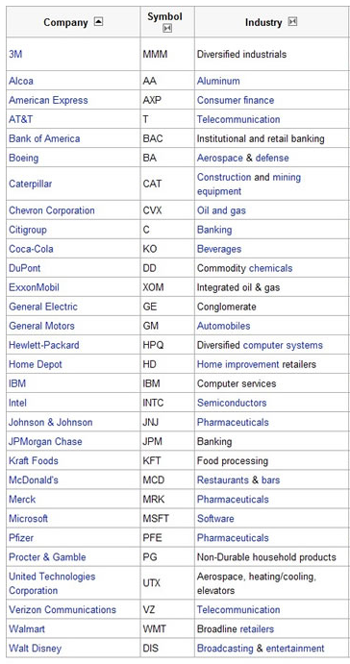
Dow Jones Industrial Average Companies

Slide 8
Would you rather
have $40,000 to spend at 2013 prices or $400,000 to spend at 1913 prices, but only be able to buy goods and services that were available in 1913?

Slide 9
Measuring Input and Output in Knowledge Industries

Slide 12
Bundling

Slide 13
Knowledge Spillovers and Innovation

Slide 15
If you could create information about a new library process for $10 but the sale of that information would only result in a $2 return, would you create that information?

Slide 16
But what if this $10 information would have value for everyone in the library industry, without hurting you?
What if the cumulative value that this $10 information would create is $100 across every library in the country?
The social return for the information you create is a $90 profit, but your private loss is still $8.

Slide 17
Examples
Libraries and book publishers
Photocopiers and academic journals

Slide 18
Consumer Surplus as an Alternative Metric

Slide 21
Agenda
The Information Economy
Measuring Input and Output in Knowledge Industries
Knowledge Spillovers and Innovation
Consumer Surplus as an Alternative Metric

Slide 22
Works Consulted
Brynjolfsson, E., & McAfee, A. (2011). Race against the machine. Lexington, MA: Digital Frontier Press.
Brynjolfsson, E., & Saunders, A. (2010). Wired for innovation. Cambridge, MA: MIT Press.
Freeland, C. (2012). Plutocrats. London, UK: Penguin Press.
Jarvis, J. (2008). What would Google do?. New York, NY: Harper Collins.
Jarvis, J. (2011). Public parts. New York, NY: Simon and Schuster.
Understanding the digital economy (2000). In Brynjolfsson E., Kahin B. Cambridge, MA: MIT Press.
Varian, H. (2004). The economics of information technology. Cambridge, UK: Cambridge University Press.

