Slide 1
The Flipped classroom model in academic libraries
SILS Showcase
2013
Ellie Horowitz, Alicia Navarro, Gina Shelton

Slide 2
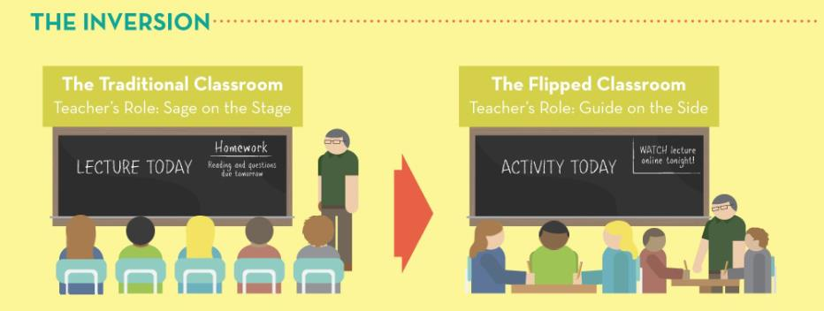
FLIPPED CLASSROOM MODEL
Photo credit: Knewton. (2012). The Flipped classroom: Turning traditional education on its head. Retrieved from http://www.knewton.com/flipped-classroom/
Notes:
Flipped classroom inverts the role of the instructor.
-Traditional: “sage on stage”. Instructor teaches to student during class time.
-Flipped: “guide on side”. Instruction occurs outside of classroom and homework, or application of knowledge, occurs in classroom.

Slide 3
THEORETICAL FRAMEWORK
LEARNING ENVIRONMENT
EDUCATIONAL TECHNOLOGY
ACTIVITY
Notes:
‘old wine in a new bottle’
How the theory works:
Educational technologies, like videos, discussion boards, interactive tools, are used to deliver content outside of classroom
Activities are implemented in the classroom that engage the learner in the content. Provides a “personalized learning experience”.
Ed Tech and Activities are used in conjunction to affect the learning environment.

Slide 4
BENEFITS
Replay
Review
Feedback
Interaction
Notes:
REPLAY: learn at your own pace. Rewatch videos.
REVIEW: reinforce concept rather than introduce
FEEDBACK: activity or seminar allows instructor to give feedback and have a dialogue
INTERACTION: fosters peer learning and enhances a student’s engagement and learning of the material

Slide 5
DRAWBACKS
Digital divide
Participation
Notes:
Digital divide: not all students have access to computers and wi-fi outside of the educational setting
Distracted engagement/Participation: instructors can’t guarantee that students will participate (or be engaged outside the classroom. One antidote: ask questions in class and if students don’t respond, pull out a quiz.
Screen time: concerns about brain development, obesity, etc.

Slide 6
APPLICATION
Using the Flipped Classroom in Academic Libraries
Retrieved from
http://www.flickr.com/photos/bogenfreund/4286076672/
Notes:
Academic instruction librarians are met with a challenge: teach students how to navigate the library and its resources AND be information literate students, all in 45-90 min session. So how can librarians make the most of that time? The Flipped Classroom model. Create online content for students to view/participate in before coming to the library session.

Slide 7
CASE STUDY
Partnership with Stevens Institute of Technology
CAL 103 course
Notes:
Partnership: Hochman approached us about partnering with Stevens to create a video to be used in conjunction with library instruction in LIS680
About Stevens: STEM institute in Hoboken NJ that educates over 6000 undergrads and grads
Cal 103: Students enrolled in the College of Arts and Letters all take CAL 103, a course that focuses on writing and communication. Students in CAL 103 attend a library instruction session that familiarizes them with the libraries’ electronic resources and the research process.

Slide 8
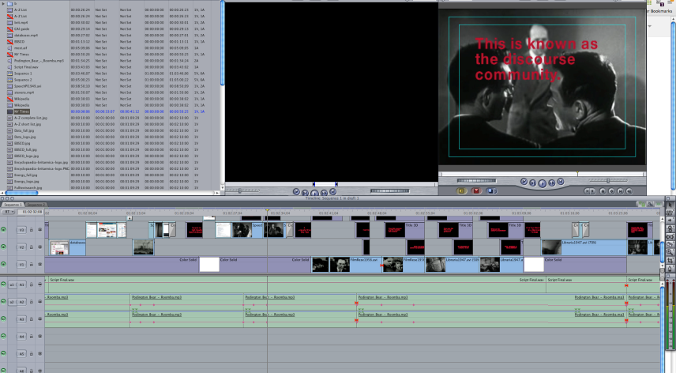
MAKING A VIDEO
Notes:
-Content: developed a script from the CAL 103 LibGuide (online library resource for CAL 103 students that outlines the research process and aggregates lists of pertinent resources), handout from the CAL 103 library session, and other related library videos
-Recording of script: used ProTools to record & create a .wav file
-Screen shots: Camtasia and SnagIt
-Video production: FinalCut Pro, audio from the Free Music Archive, found footage from Internet Archive

Slide 9
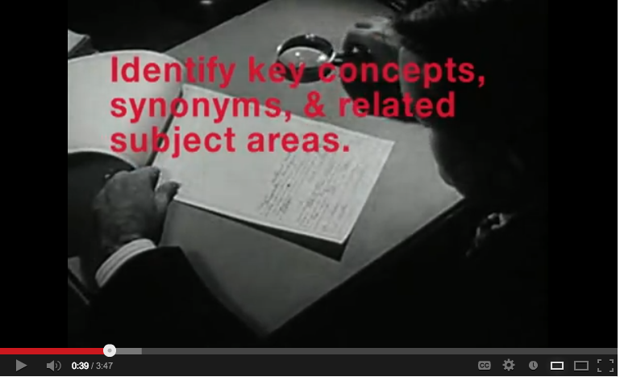
VIDEO

Slide 10
QUESTIONS?
Ellie Horowitz: @ellieatoric
Alicia Navarro: @alicris
Gina Shelton: @ginamshelton

